Slide 1
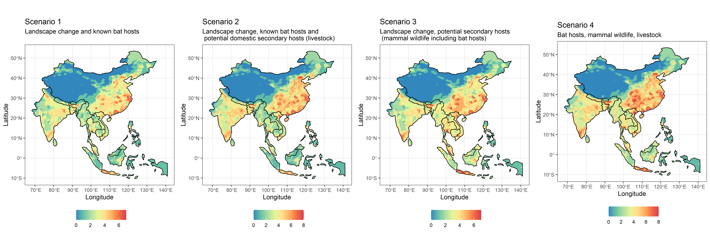
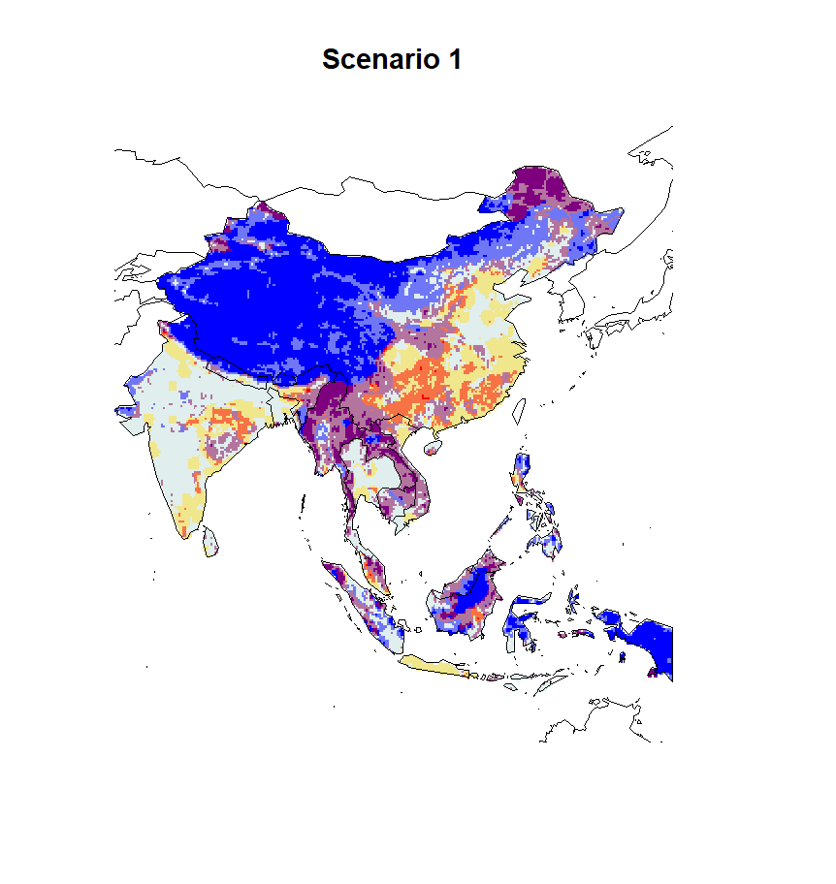


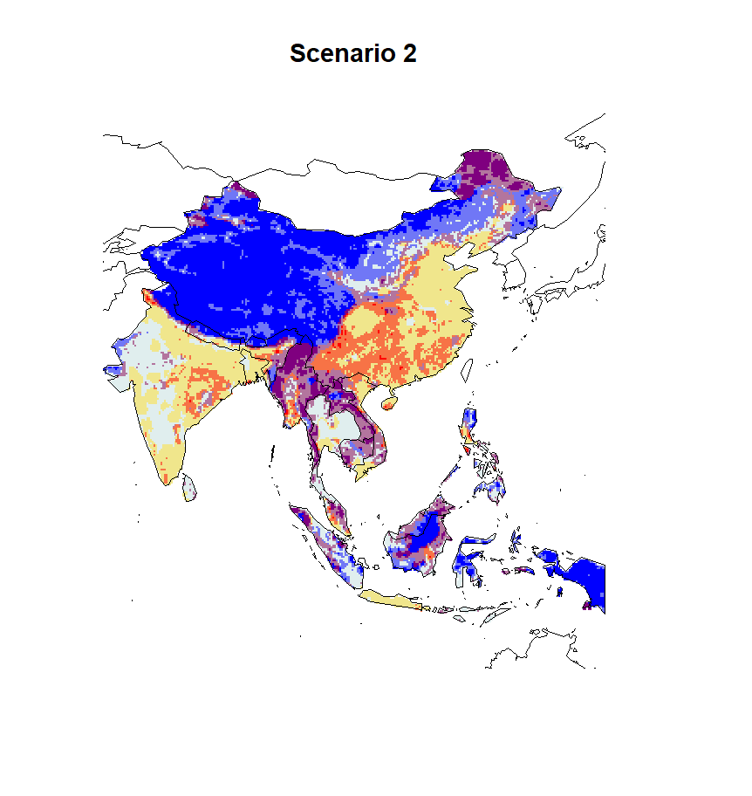

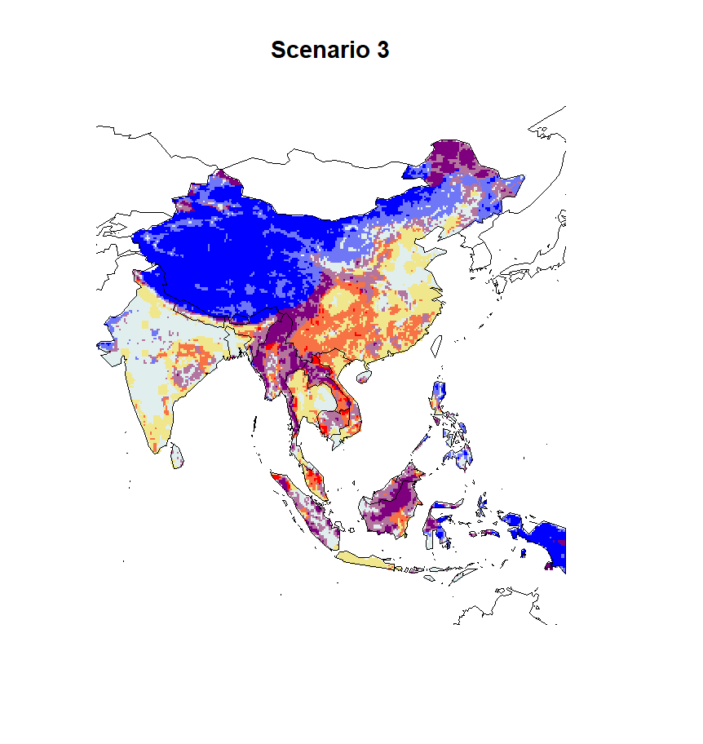
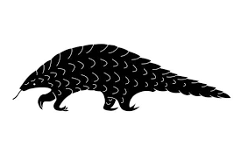
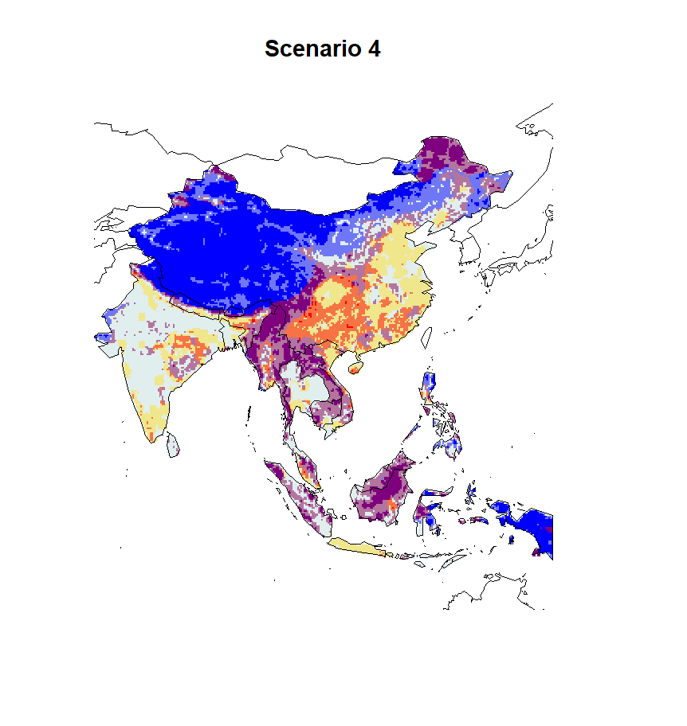
*
*

Slide 3
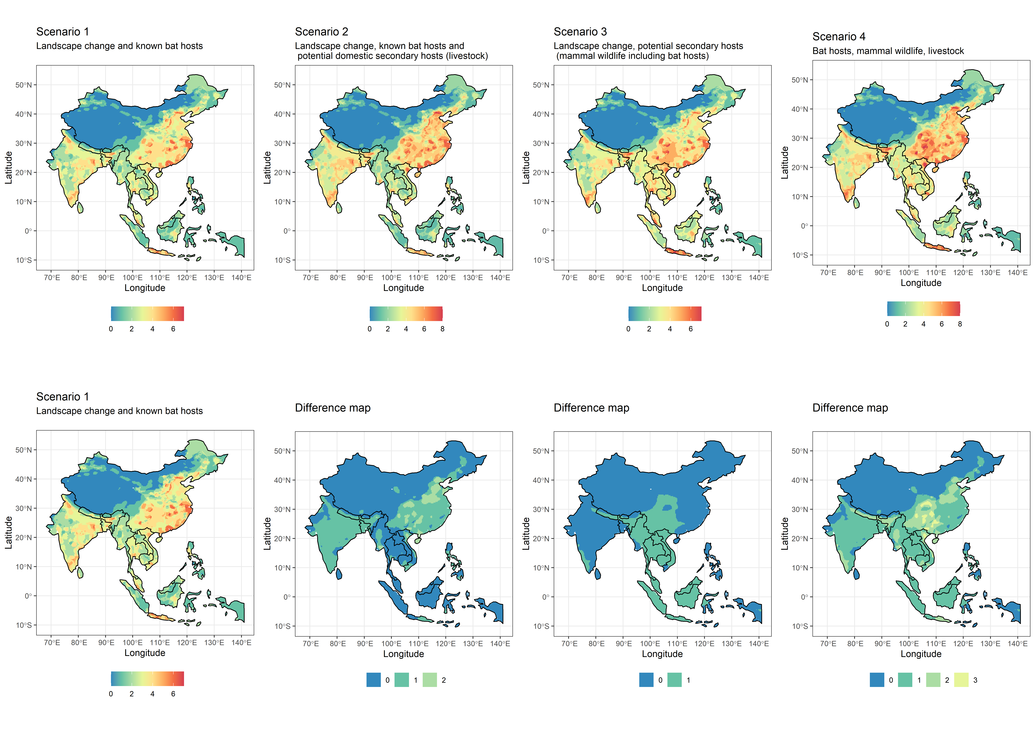

Slide 4
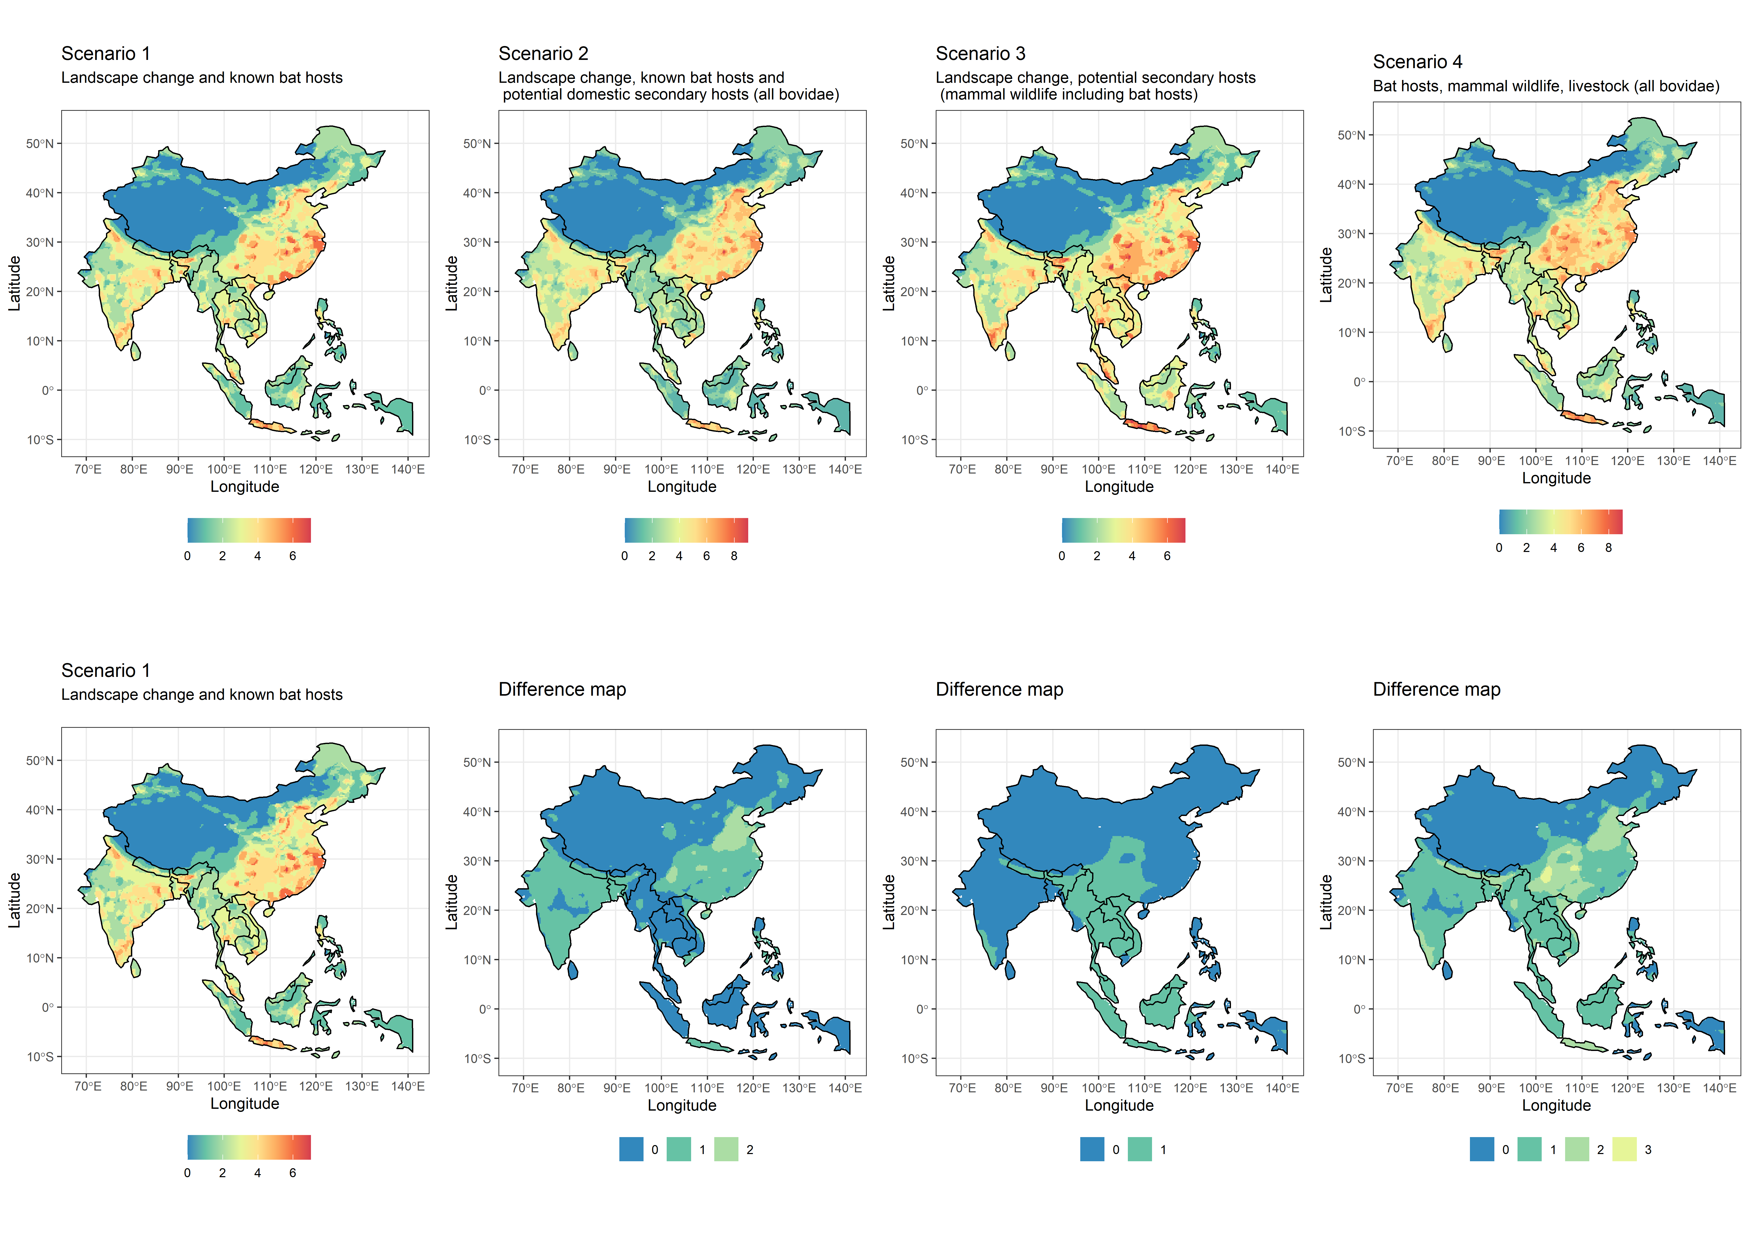

Slide 5
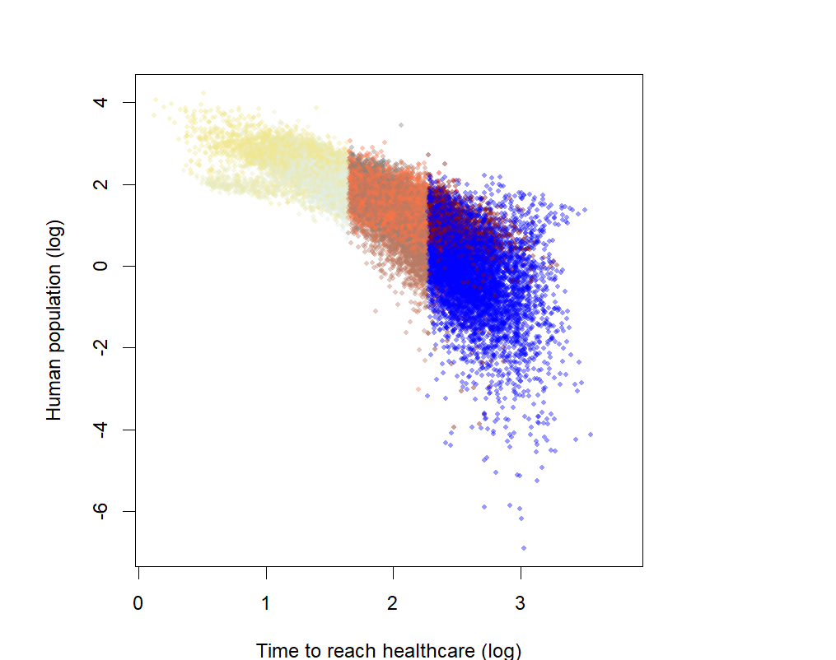
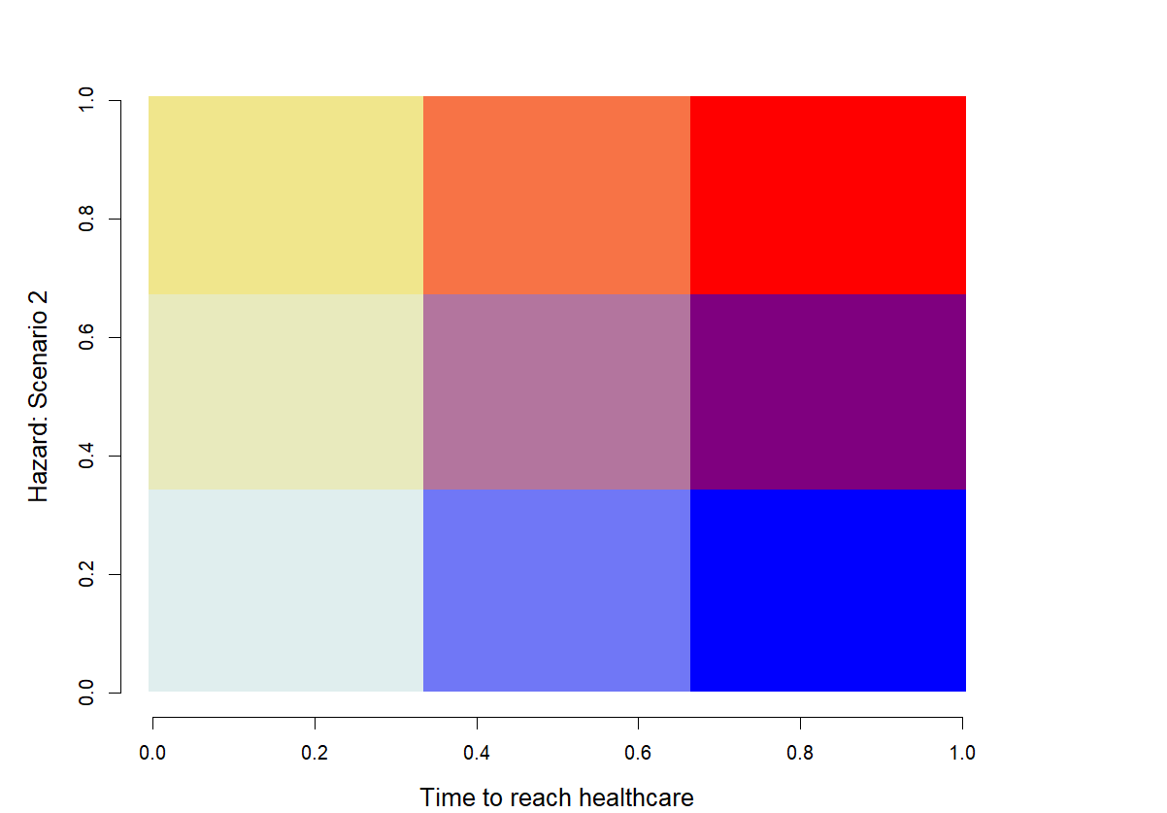
High potential for Spread
Spillover debt:
Urgent action
Moderate priority for discovery,
prioritise understanding known hosts
Prioritize
OneHealth,
Host discovery
and public health access
(surveillance, fixed and mobile clinics)
Host bias reduction and prevention from surveillance
Spillover risk
Safer zones
Conditionally safer zones:
focus on other
risks reduction
- Time to reach healthcare +

Slide 9
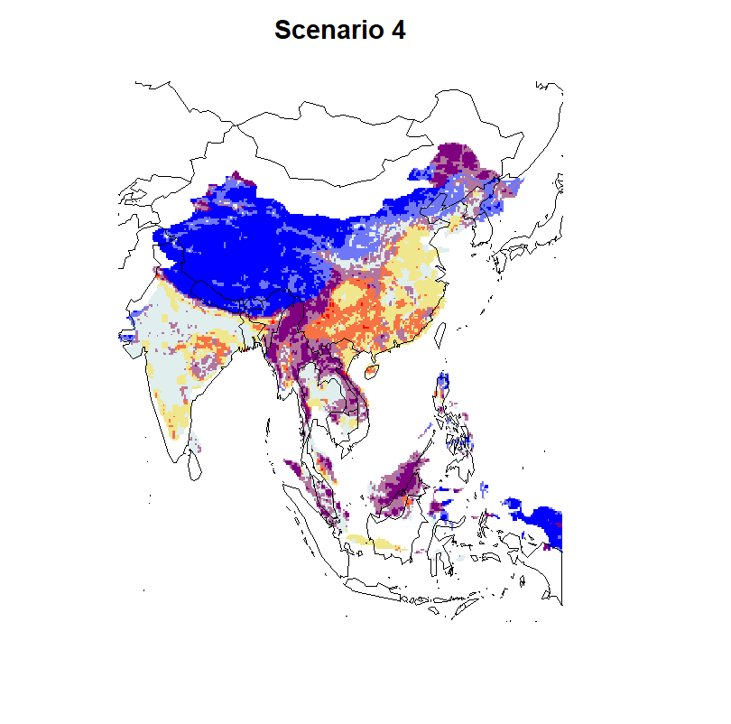

Slide 10
3
9
12
2
8
11
- Hazard: Scenario 1 +
1
7
10
- Time to reach healthcare +

Slide 11
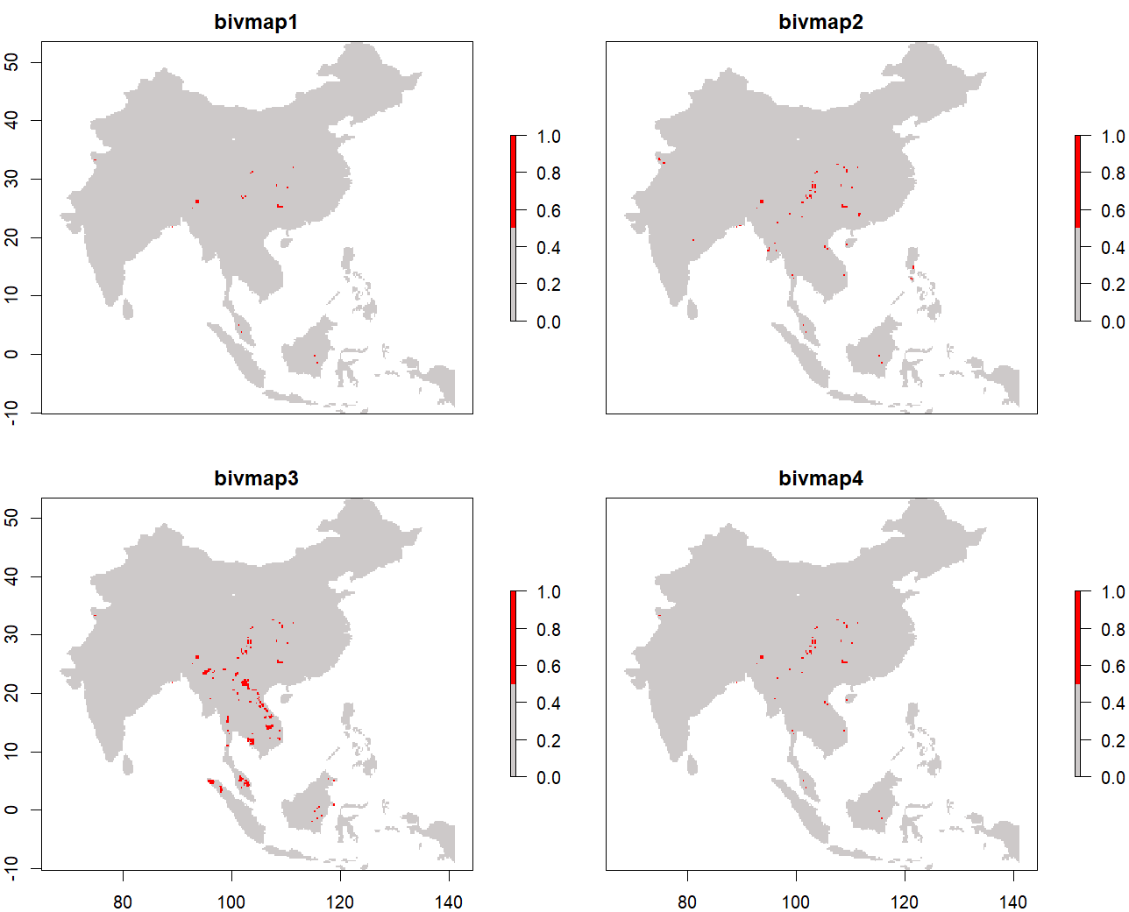
26 red areas
78 red areas
236 red areas
59 red areas

Slide 12
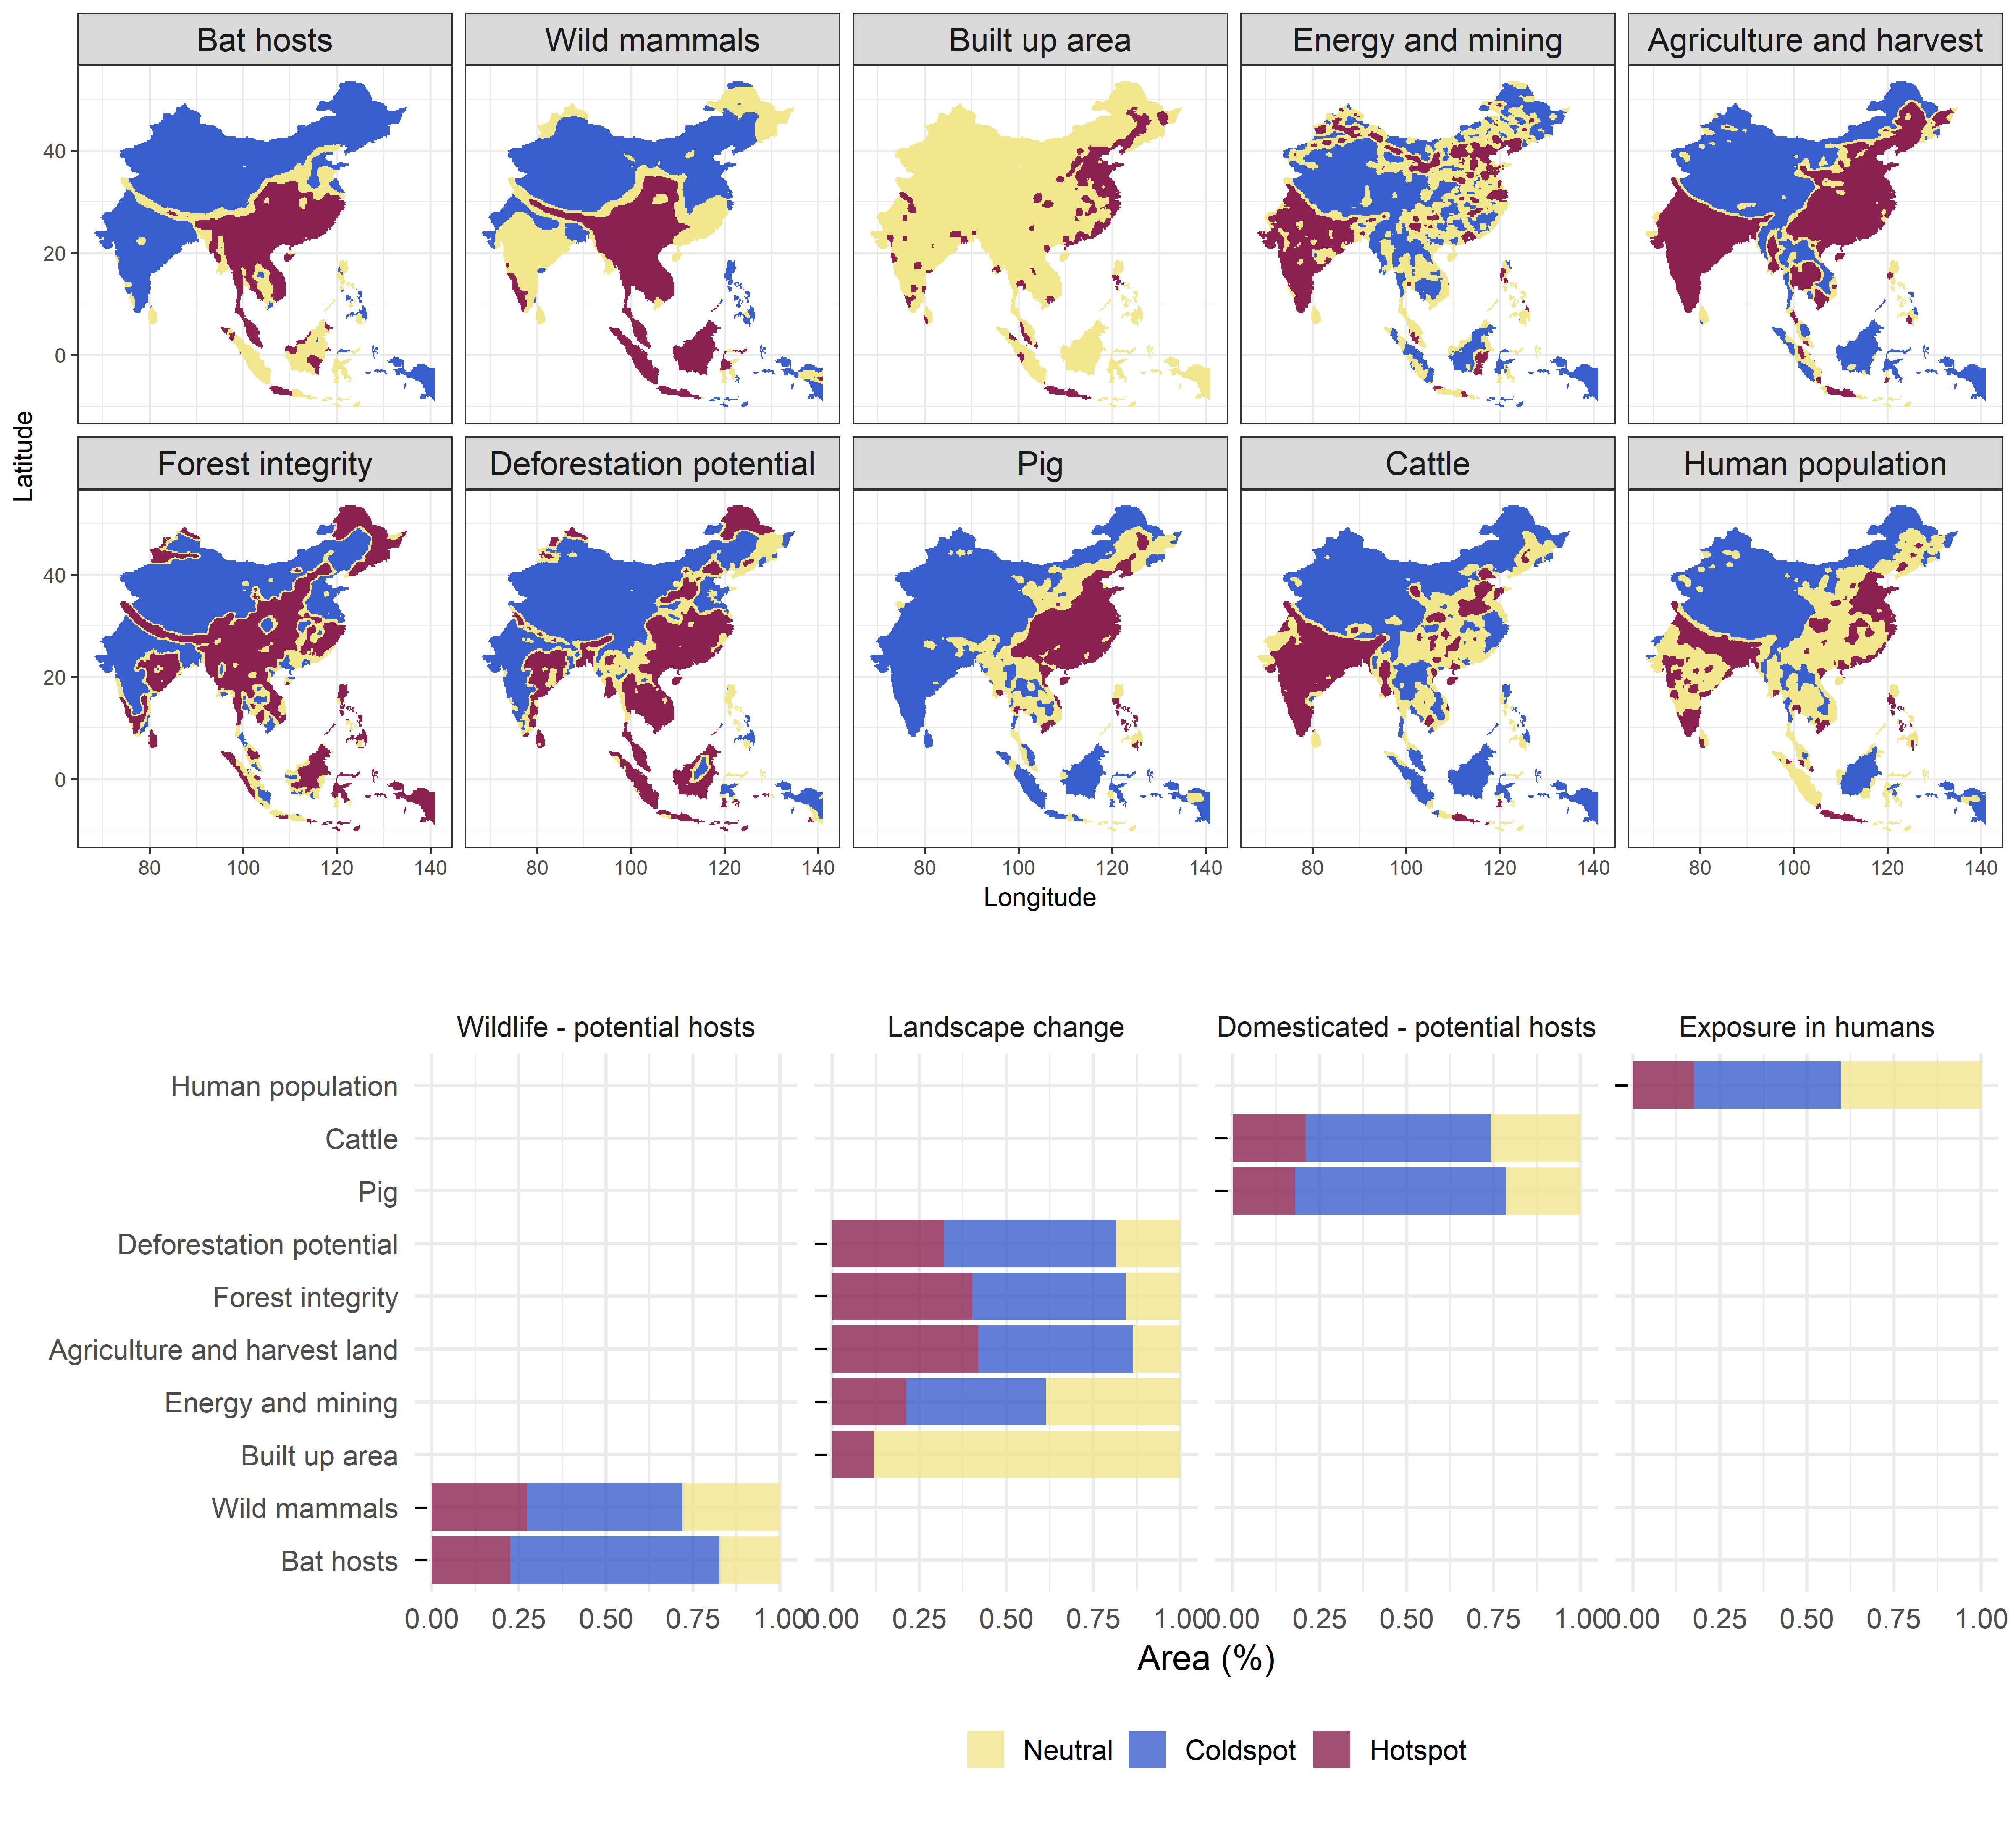
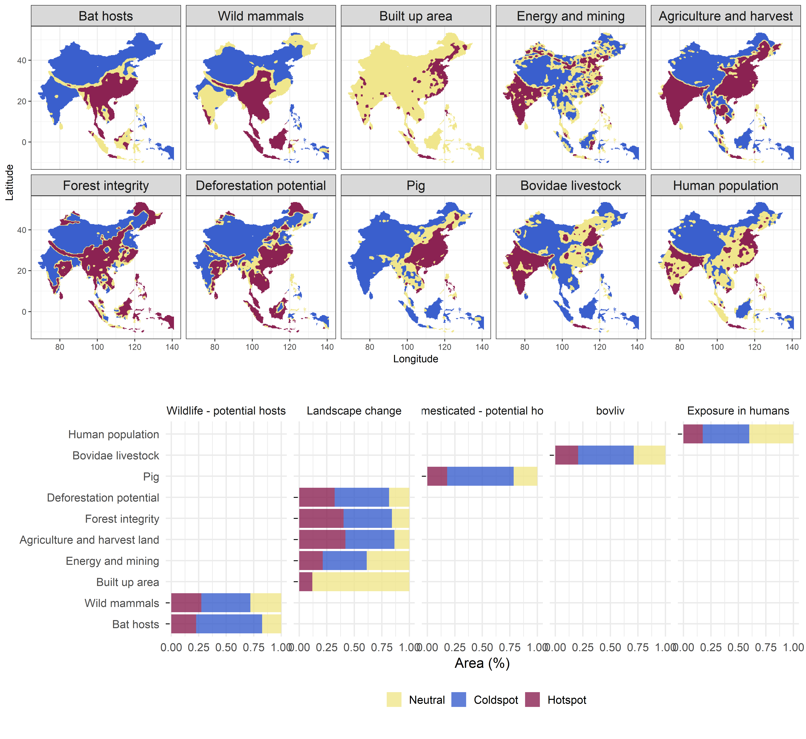


Changes on what is the mammal layer:
Previously: all mammals (deleted)
Now: all mammals minus bat hosts (mmb)
Inclusion of all bovidae livestock (buffalo+sheep+goat+cattle) in comparison with cattle: present cattle OR bovidae livestock in the main text and the other in the supplements.

Slide 13
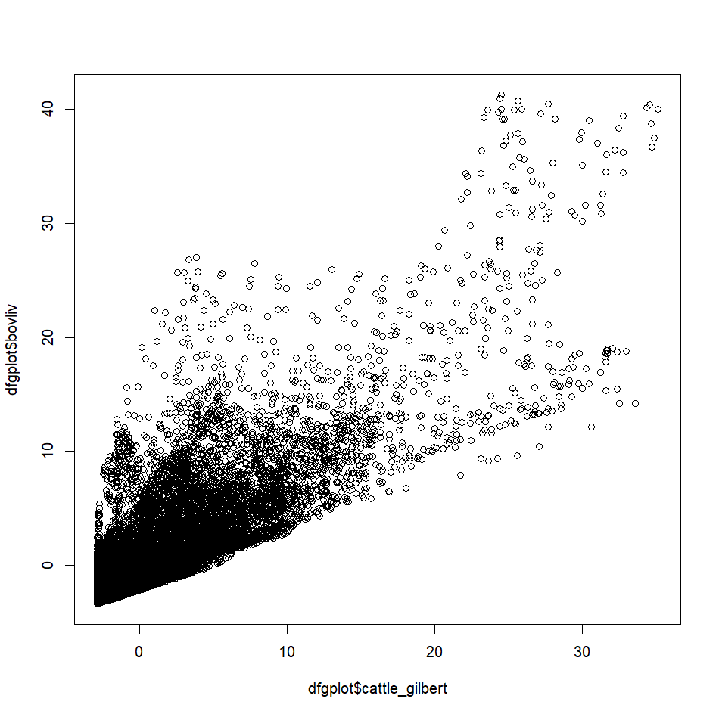
Summing buffalo+cattle+goats+sheep makes the hotspots less intense, by spatially evenning out their value. This may be even more realistic for hazard?
buffalo_cattle_goat_sheep
> max(p$cattle_gilbert)
[1] 68677.8
> max(p$buffalo_cattle_goat_sheep)
[1] 104970.1
cattle

Slide 14
Changes on what is the mammal layer:
Previously: all mammals (deleted)
Now: all mammals minus bat hosts (mmb)
Inclusion of all bovidae livestock (buffalo+sheep+goat+cattle) in comparison with cattle: present cattle OR bovidae livestock in the main text and the other in the supplements.
Changes in scenario 2: tests with 4 scenarios
Scenario 2 cattle: Bat Hosts + mammals mmb + pig + cattle + everything else
Scenario 2 all bovidae: Bat Hosts + mammals mmb + pig + bovidae livestock + everything else
Reason to stay: nested with scenario 1. ‘It is the reality’, as every layer is out there
Reason to delete: it pushes away from checking differences with scenario one.
Scenario 2 no bat hosts cattle: mammals mmb + pig + cattle + everything else
Scenario 2 no bat hosts all bovidae: mammals mmb + pig + bovidae livestock + everything else
Reason to stay: Because it is not nested with scenario 1, we can see differences better (‘bat host’ excess can be approximated to bigger risks, or a model focused on SARS-like covs in scenario 1, while scenario 2 is general risk of zoonotic infectious diseases)
Reason to delete: -

Slide 15
1) landuse+ & people & bats; [direct transmission]
2) landuse+ & people & bats; + livestock [livestock intermediate host]
3) landuse+ & people & bats; + wild mammals [wild mammal intermediate hosts]
4) landuse+ & people & bats; + livestock + wild mammals [wild mammal & livestock intermediate hosts]

Slide 16


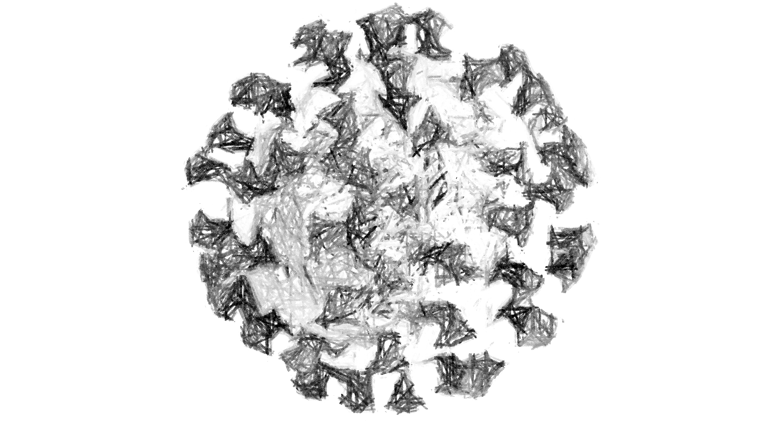
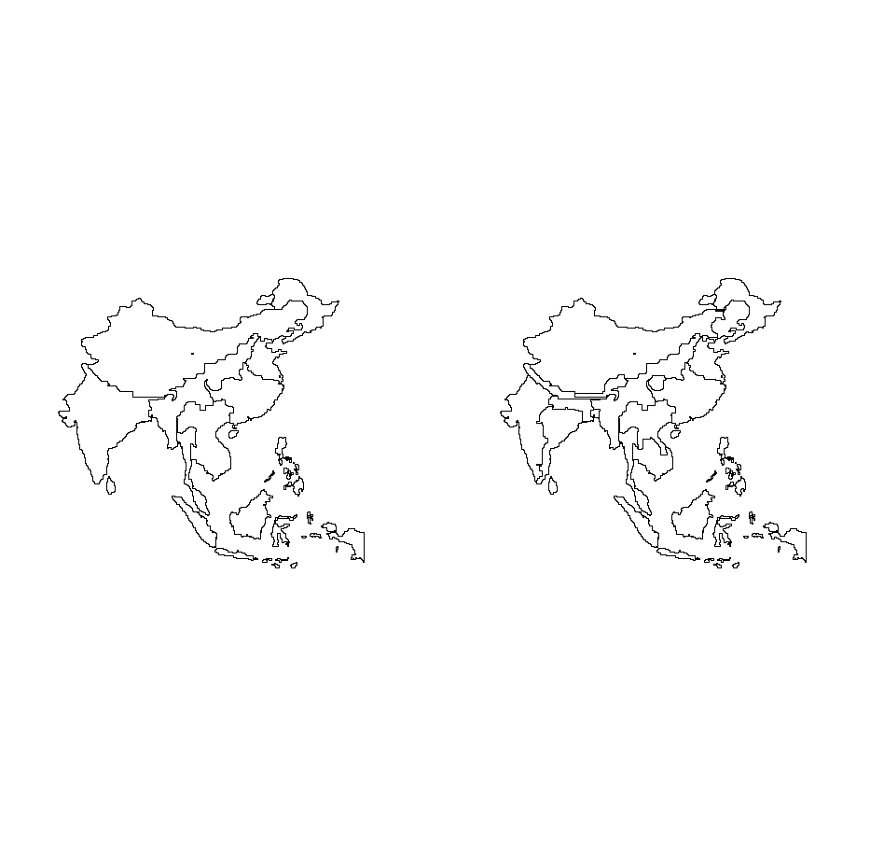
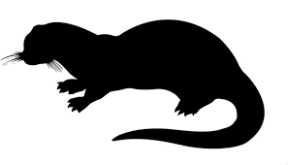
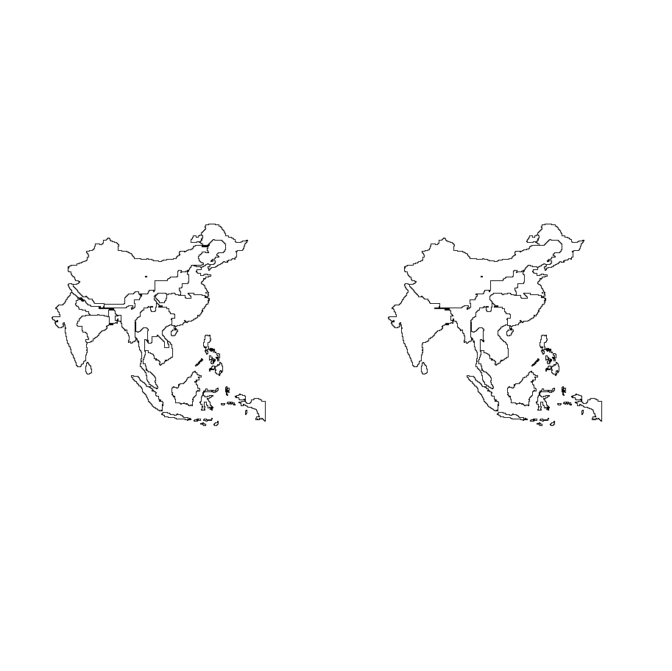
9 clusters
cattle
19 clusters
19 clusters
9 clusters
all bovidae livestock

Slide 17
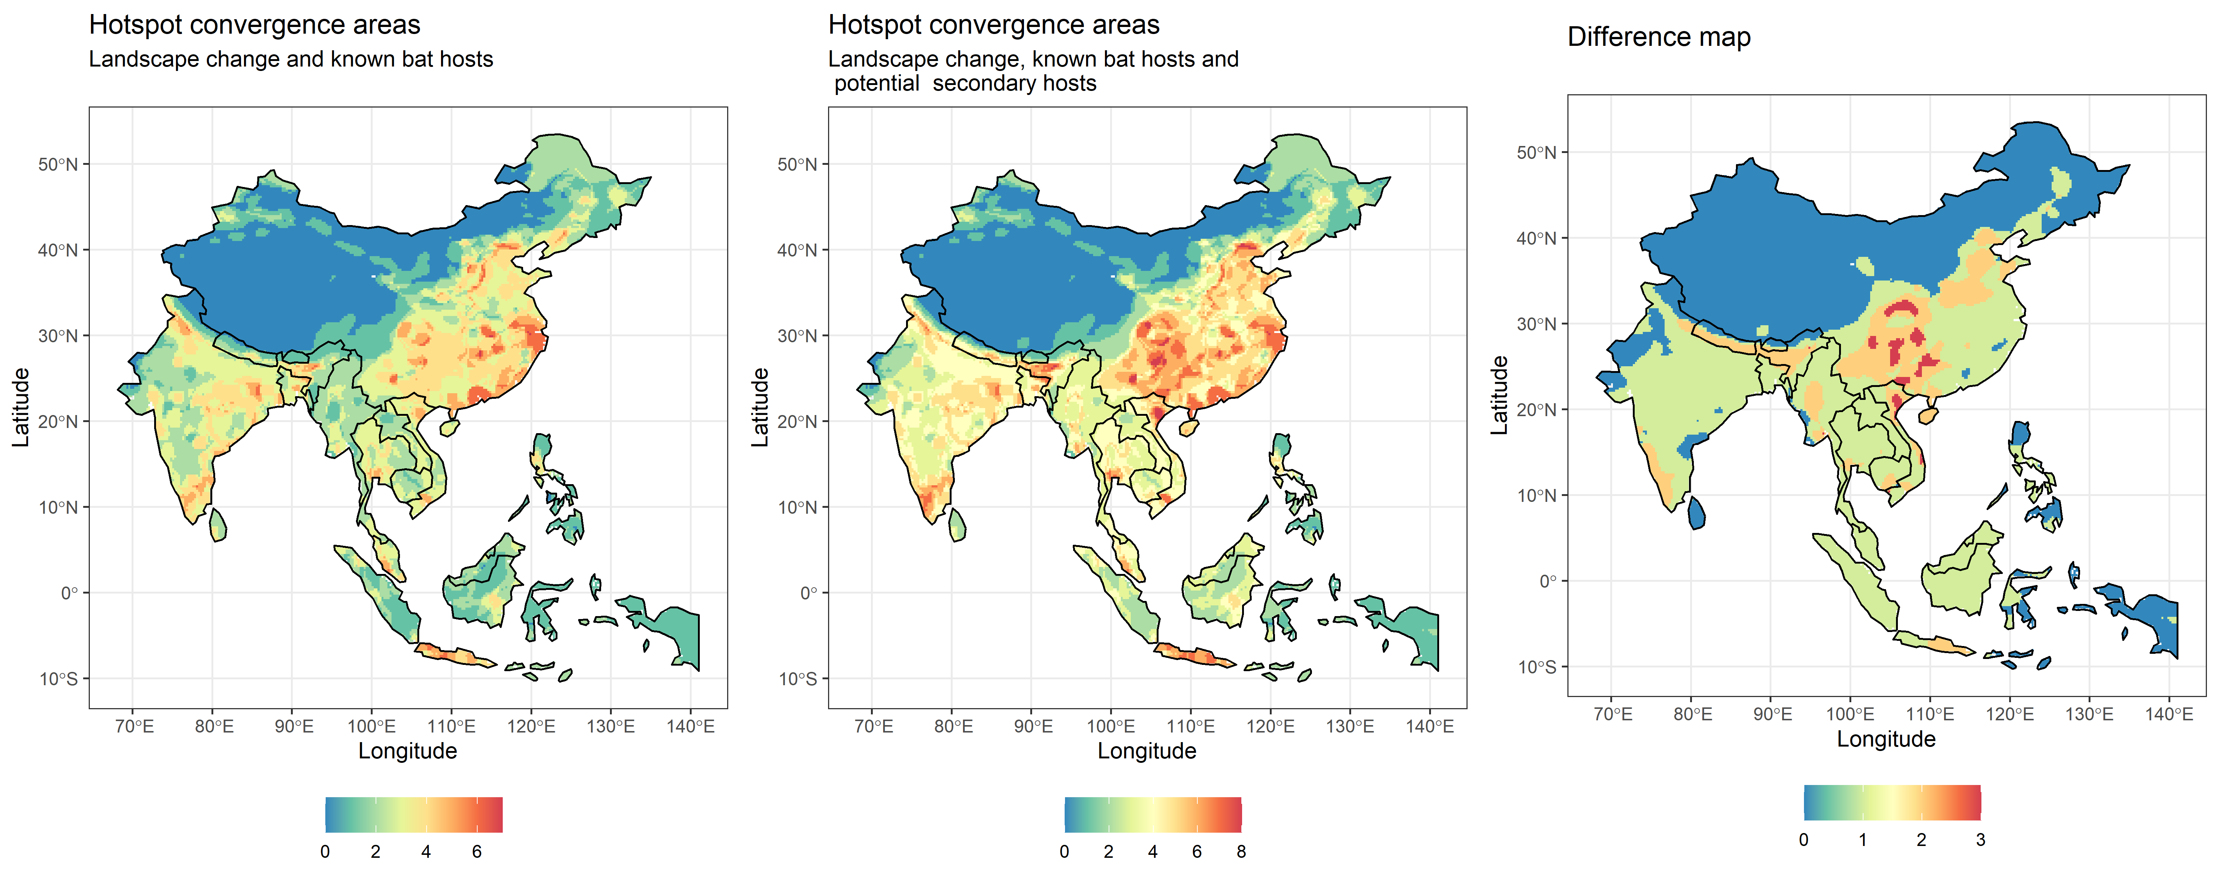
Bat Hosts + mammals mmb + pig + cattle + everything else
table(db$n_hotspots_risk2 - db$n_hotspots_risk1)
0 1 2 3
12093 10569 2816 318

Slide 18
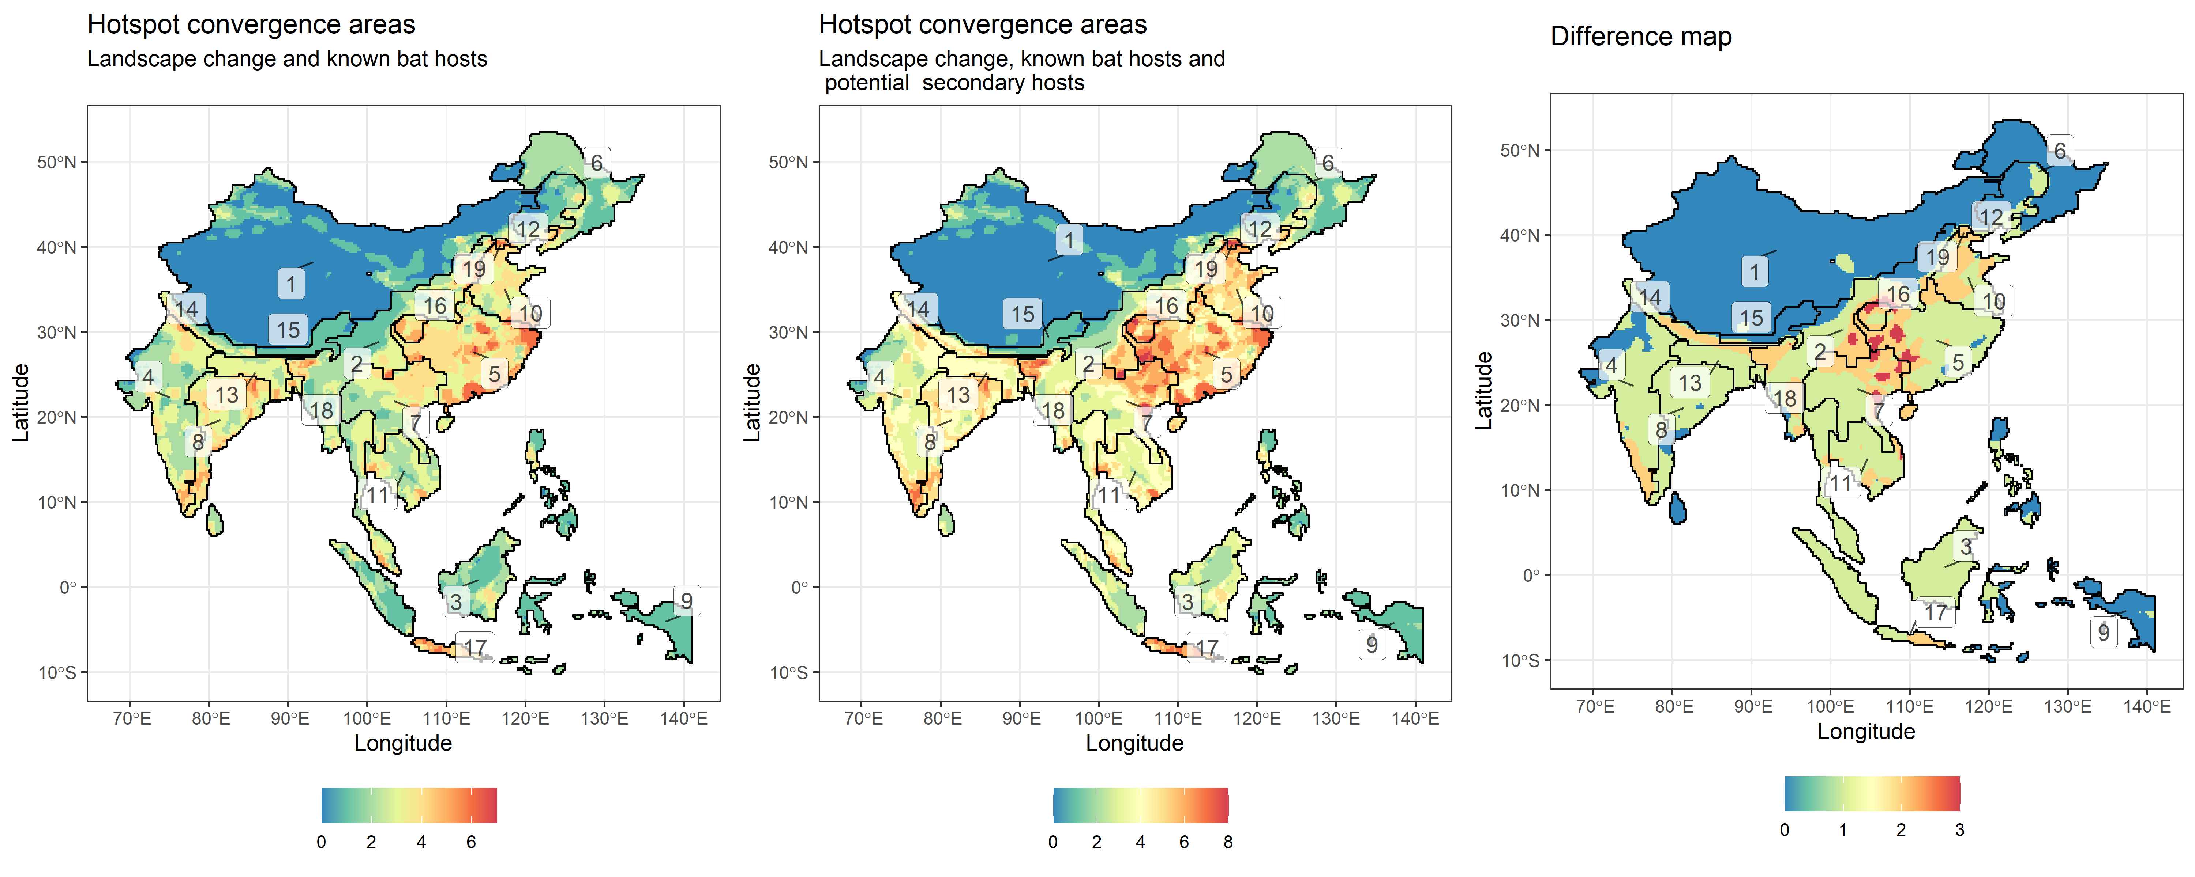
Bat Hosts + mammals mmb + pig + cattle + everything else

Slide 19
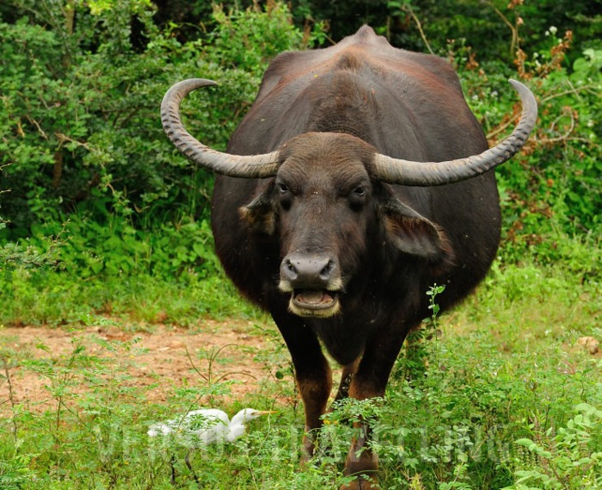
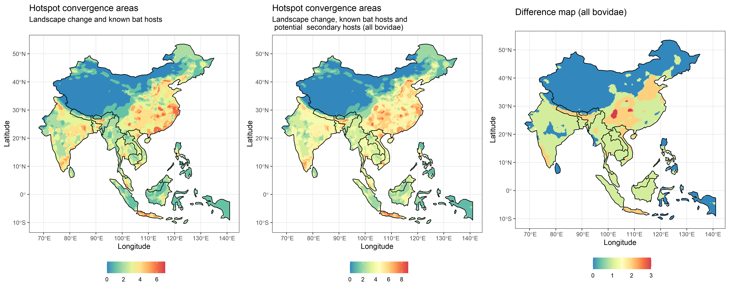
Bat Hosts + mammals mmb + pig + bovidae livestock + everything else

Slide 20
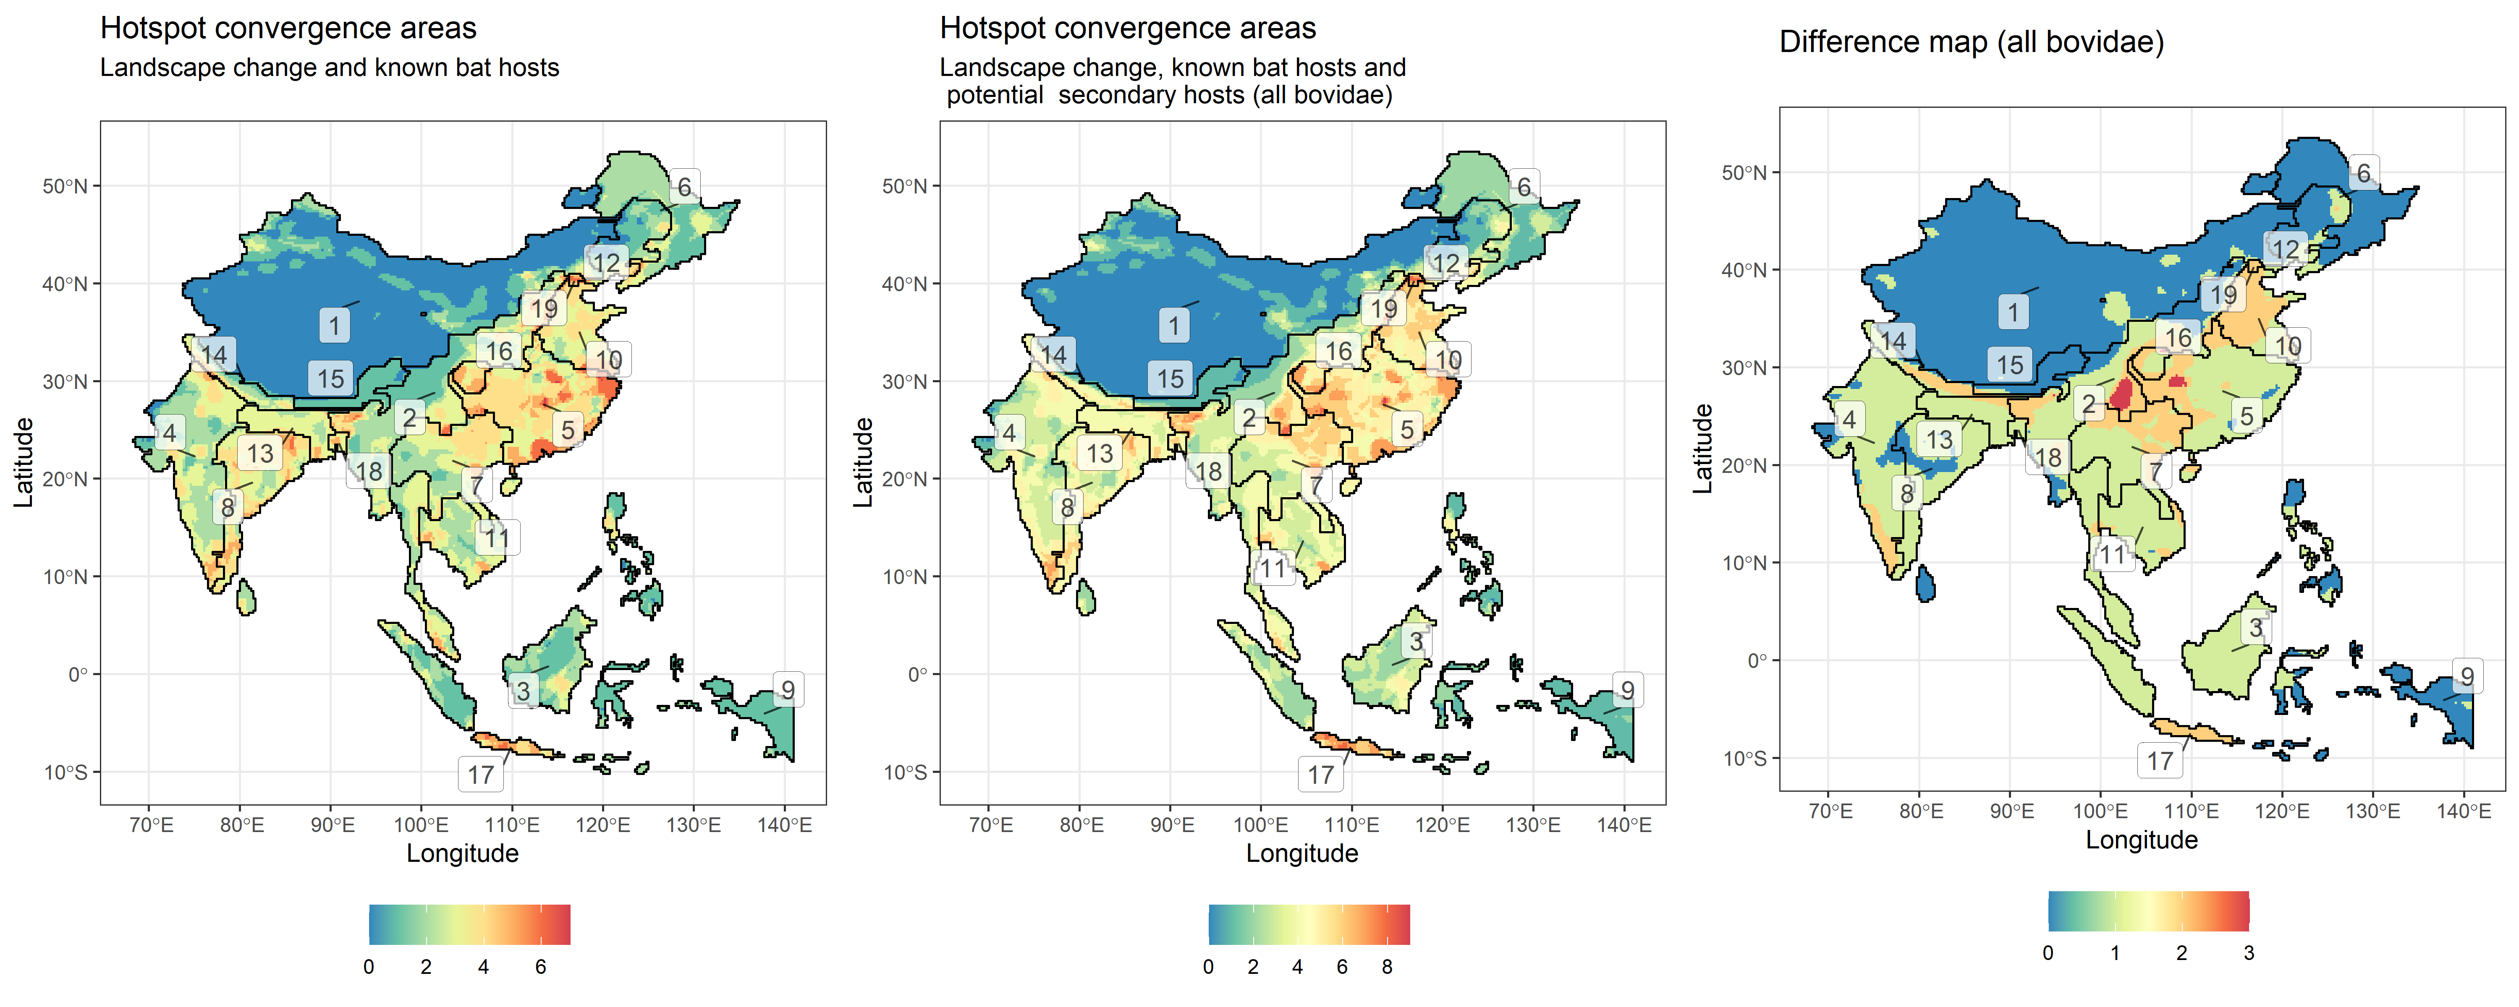
Bat Hosts + mammals mmb + pig + bovidae livestock + everything else

Slide 21
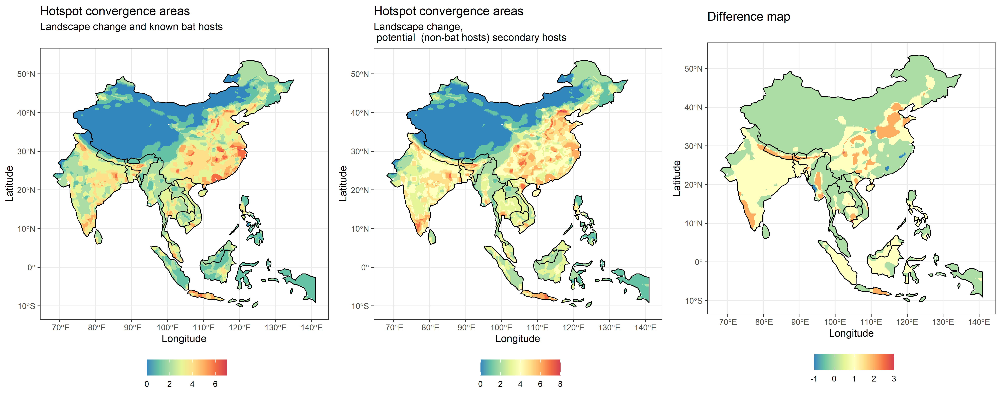
mammals mmb + pig + cattle + everything else
dif
-1 0 1 2 3
74 15908 8229 1580 5

Slide 22
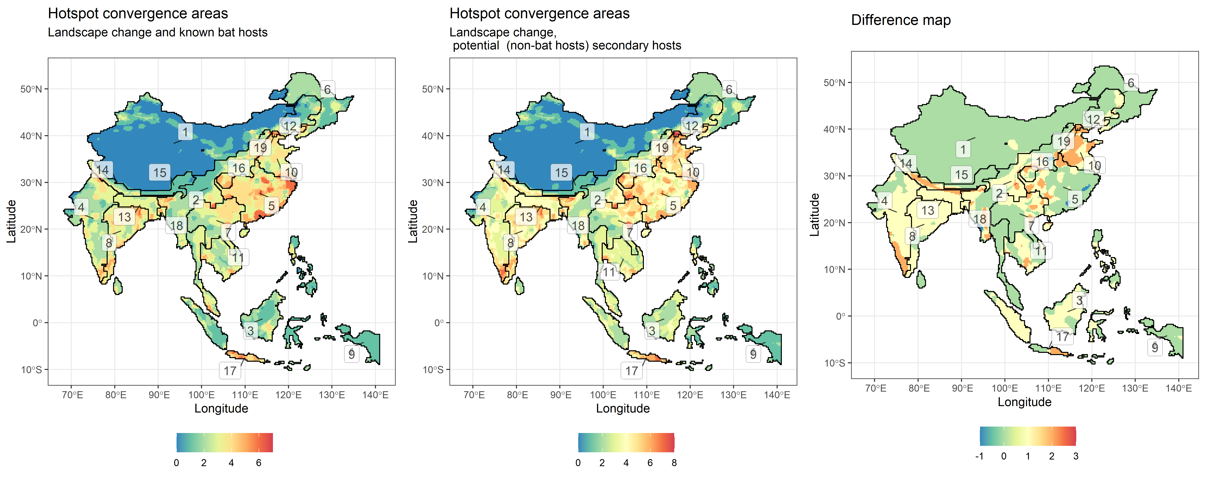
mammals mmb + pig + cattle + everything else

Slide 23
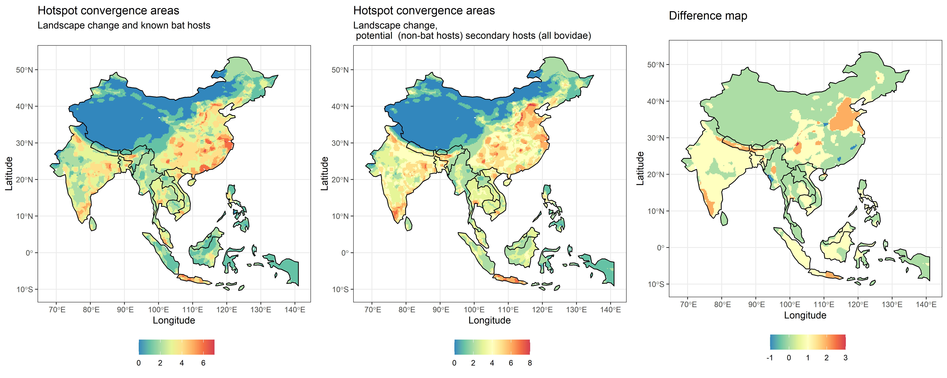
mammals mmb + pig + bovidae livestock + everything else

Slide 24
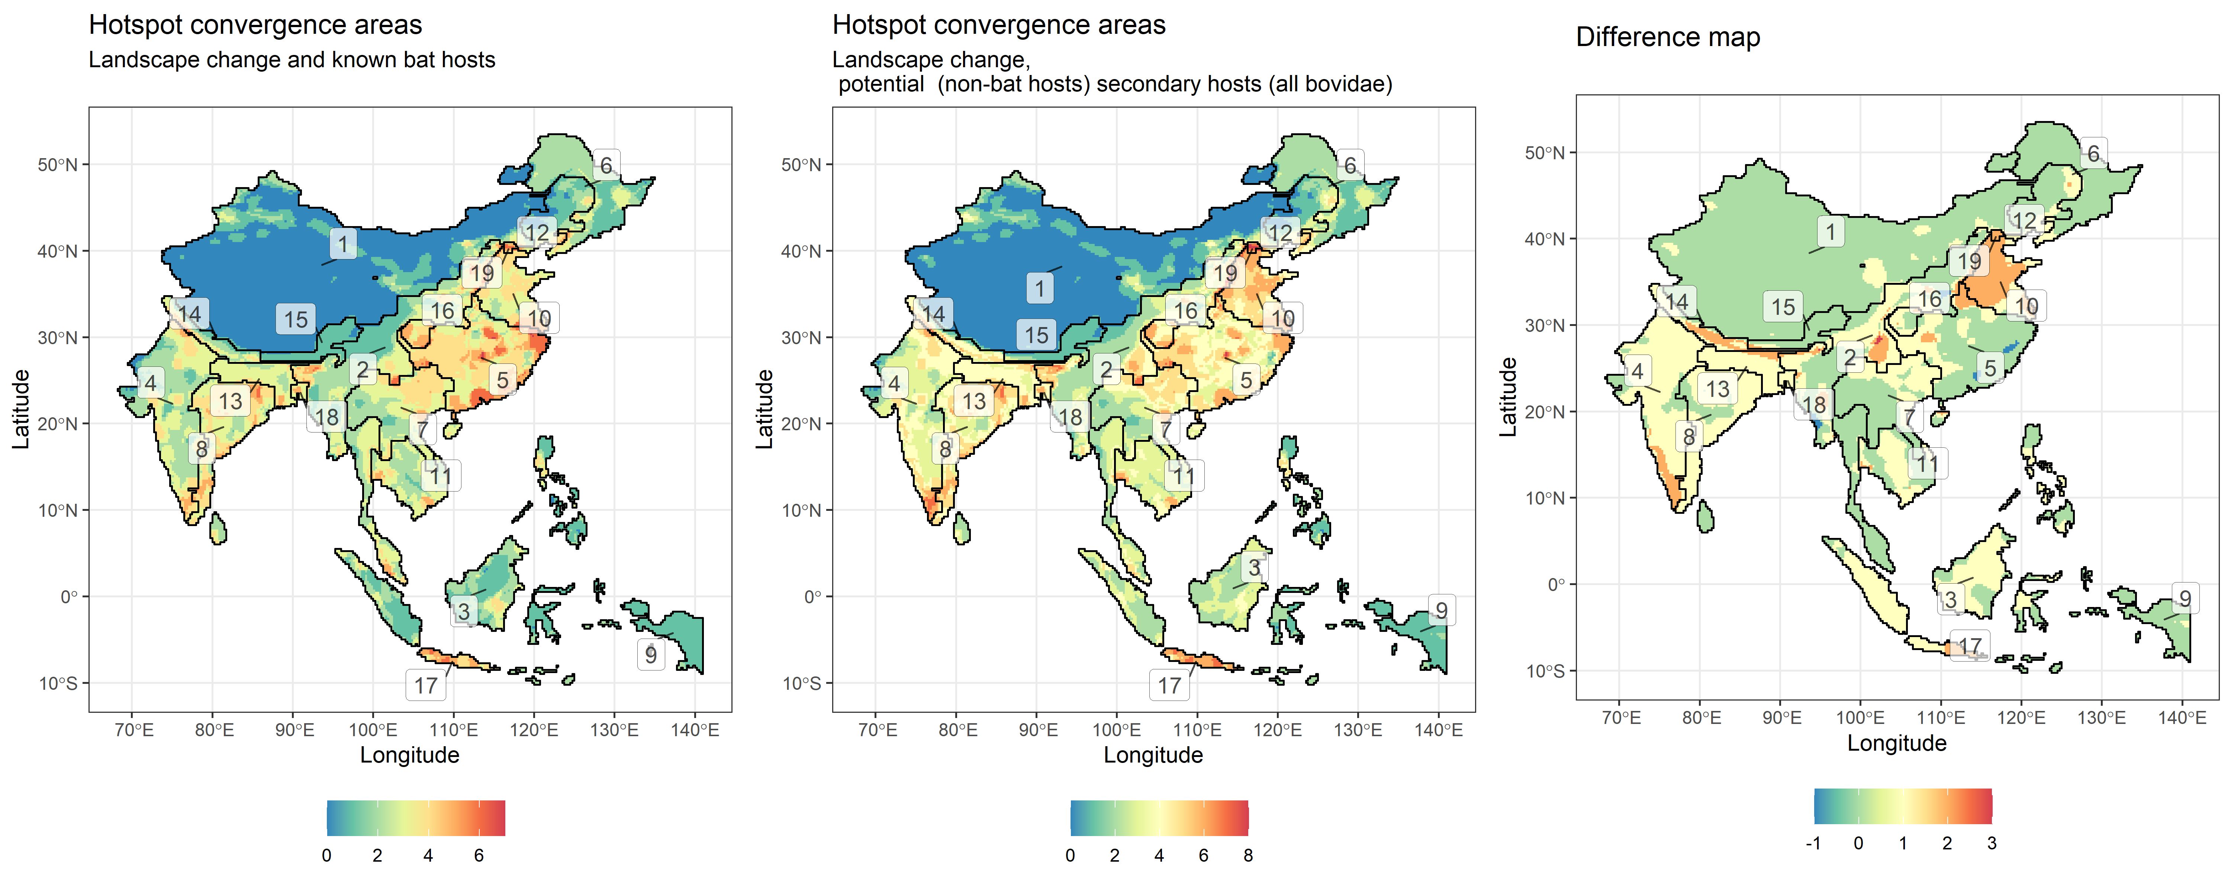
mammals mmb + pig + bovidae livestock + everything else

Slide 25
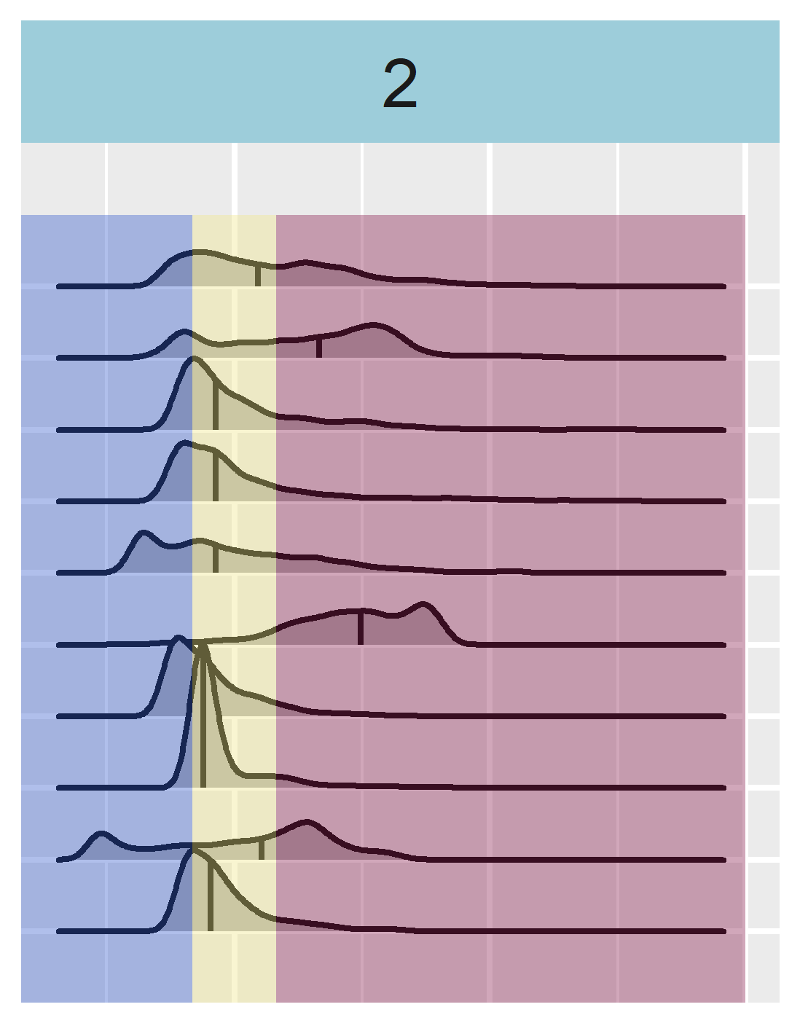
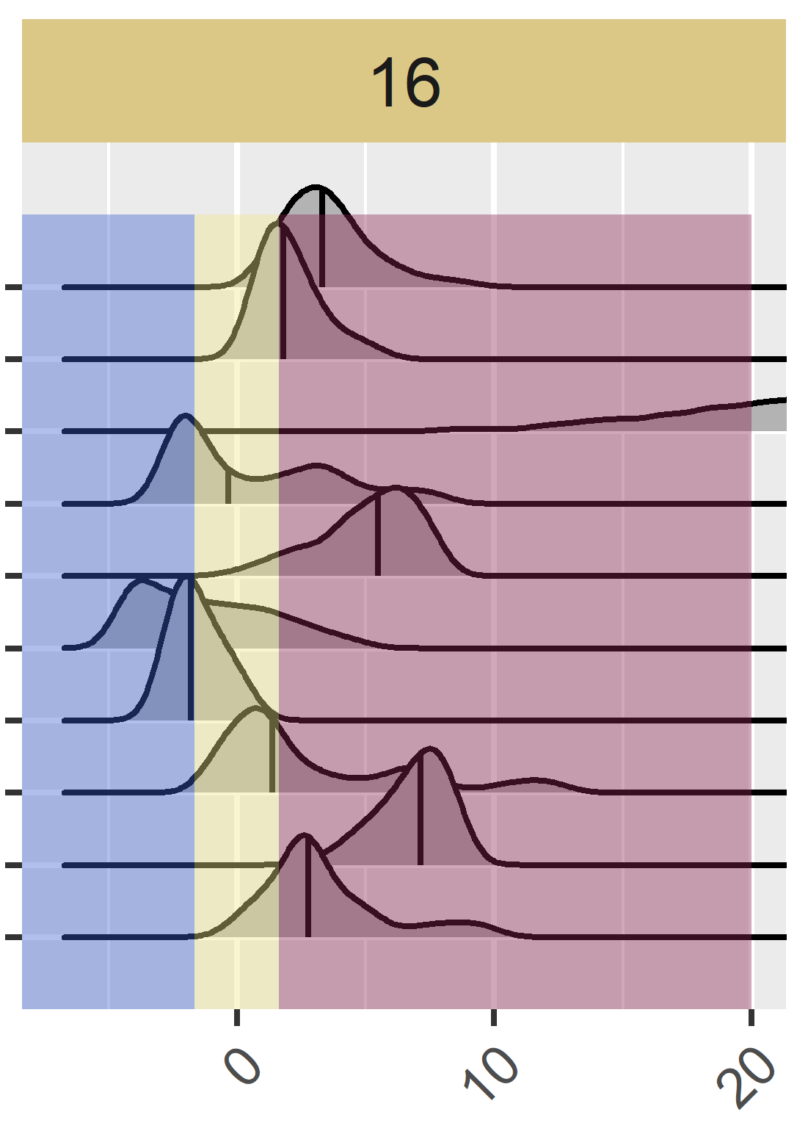
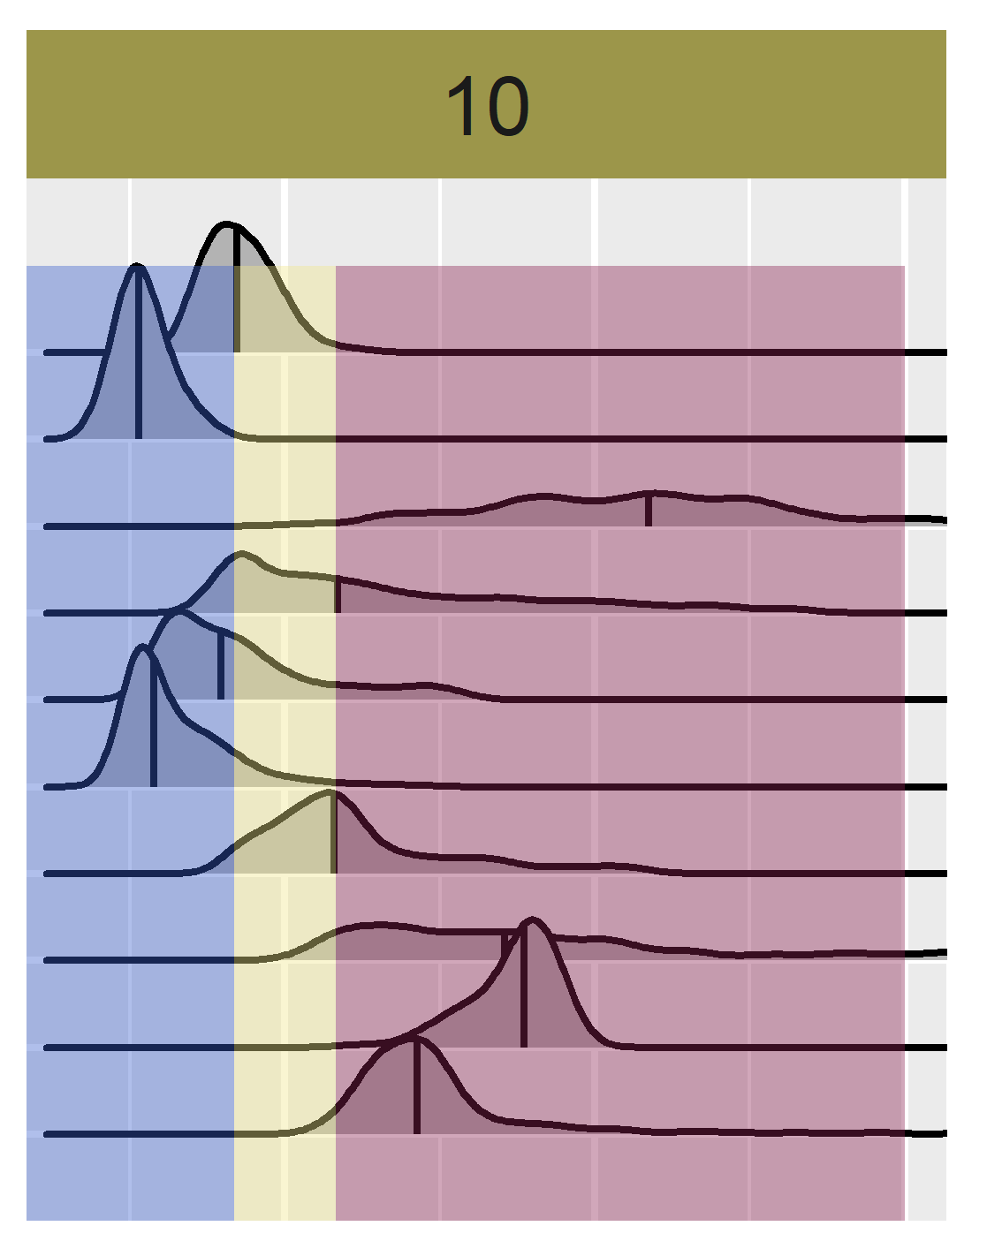
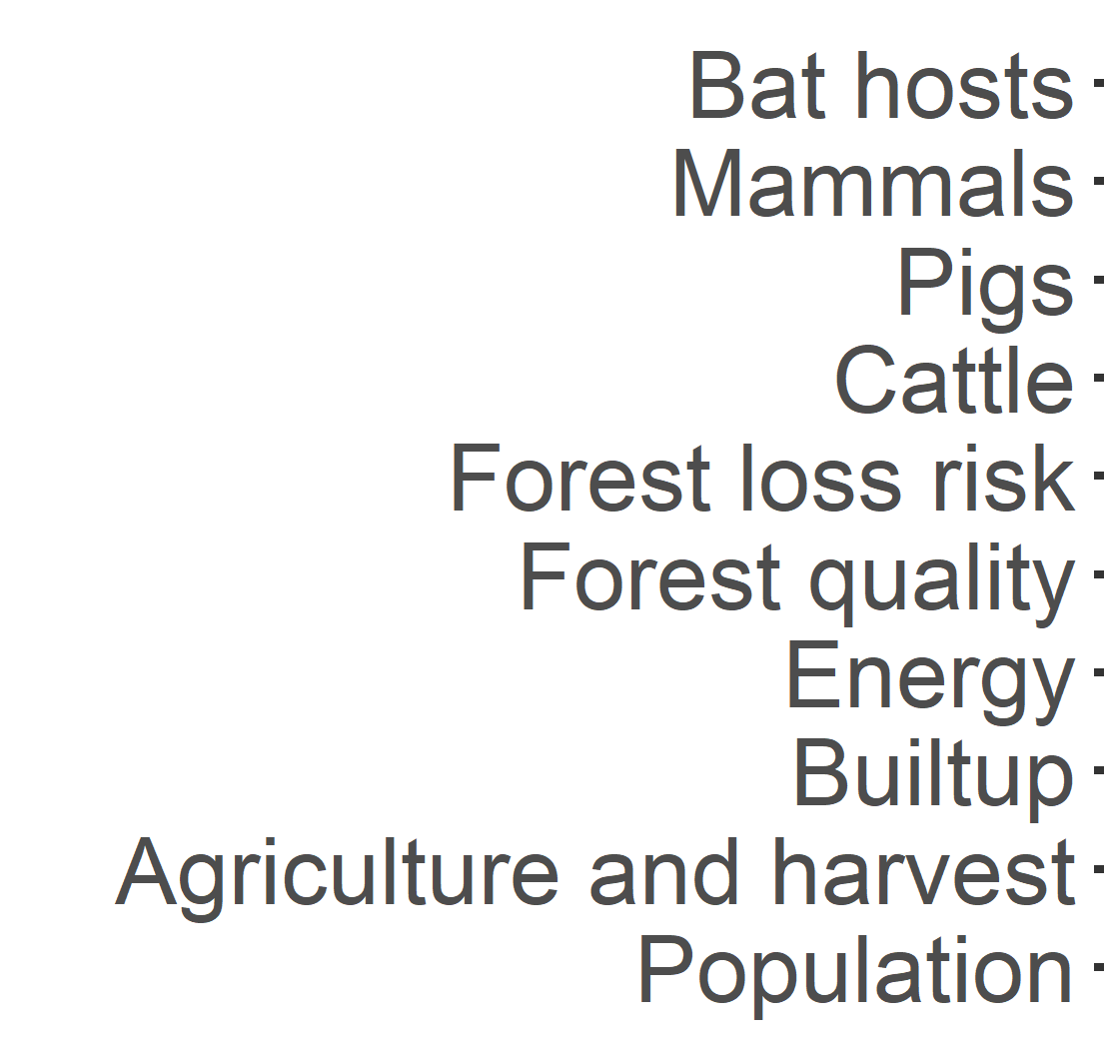

Slide 26
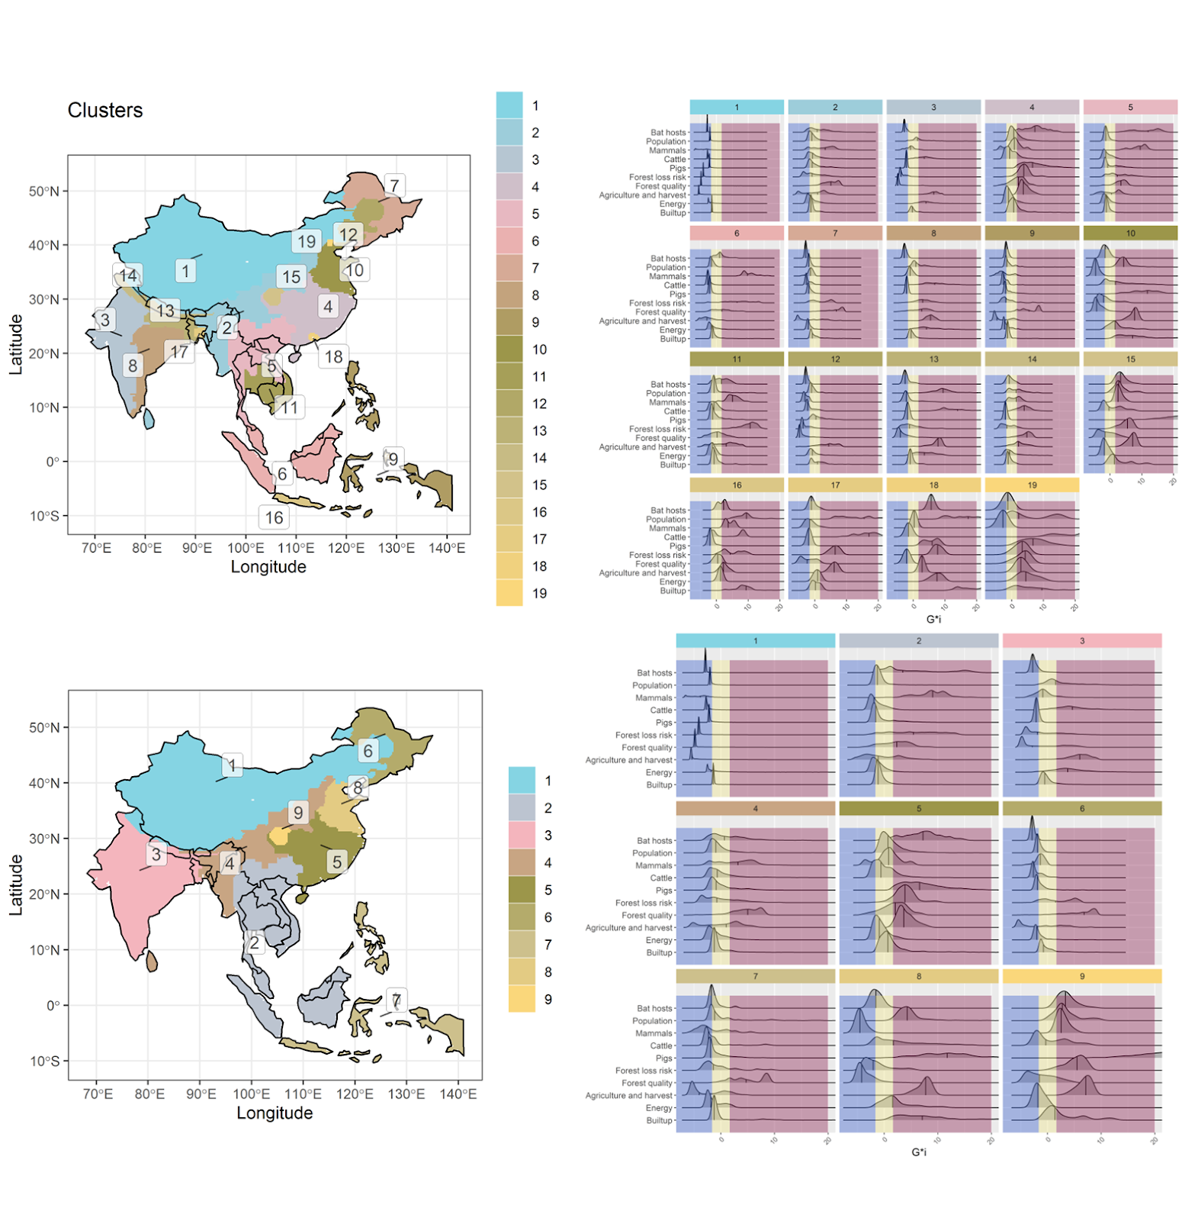
old

Slide 27
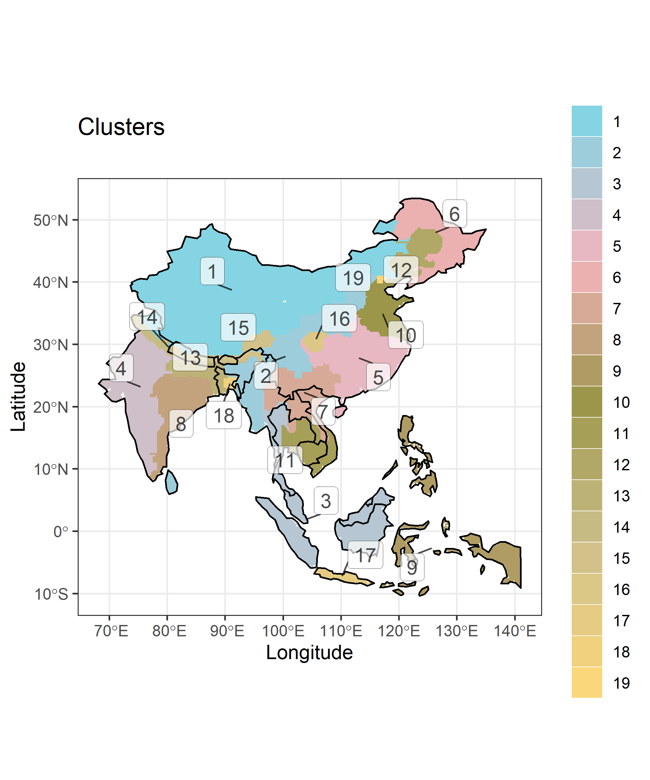

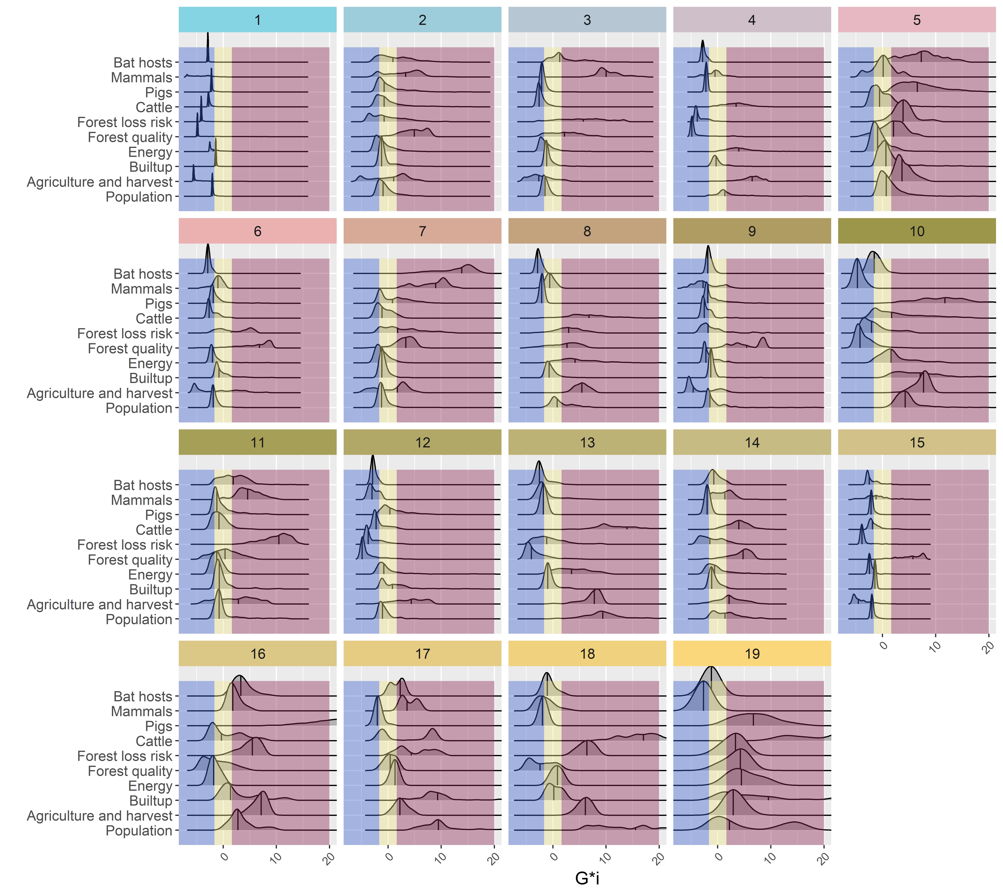
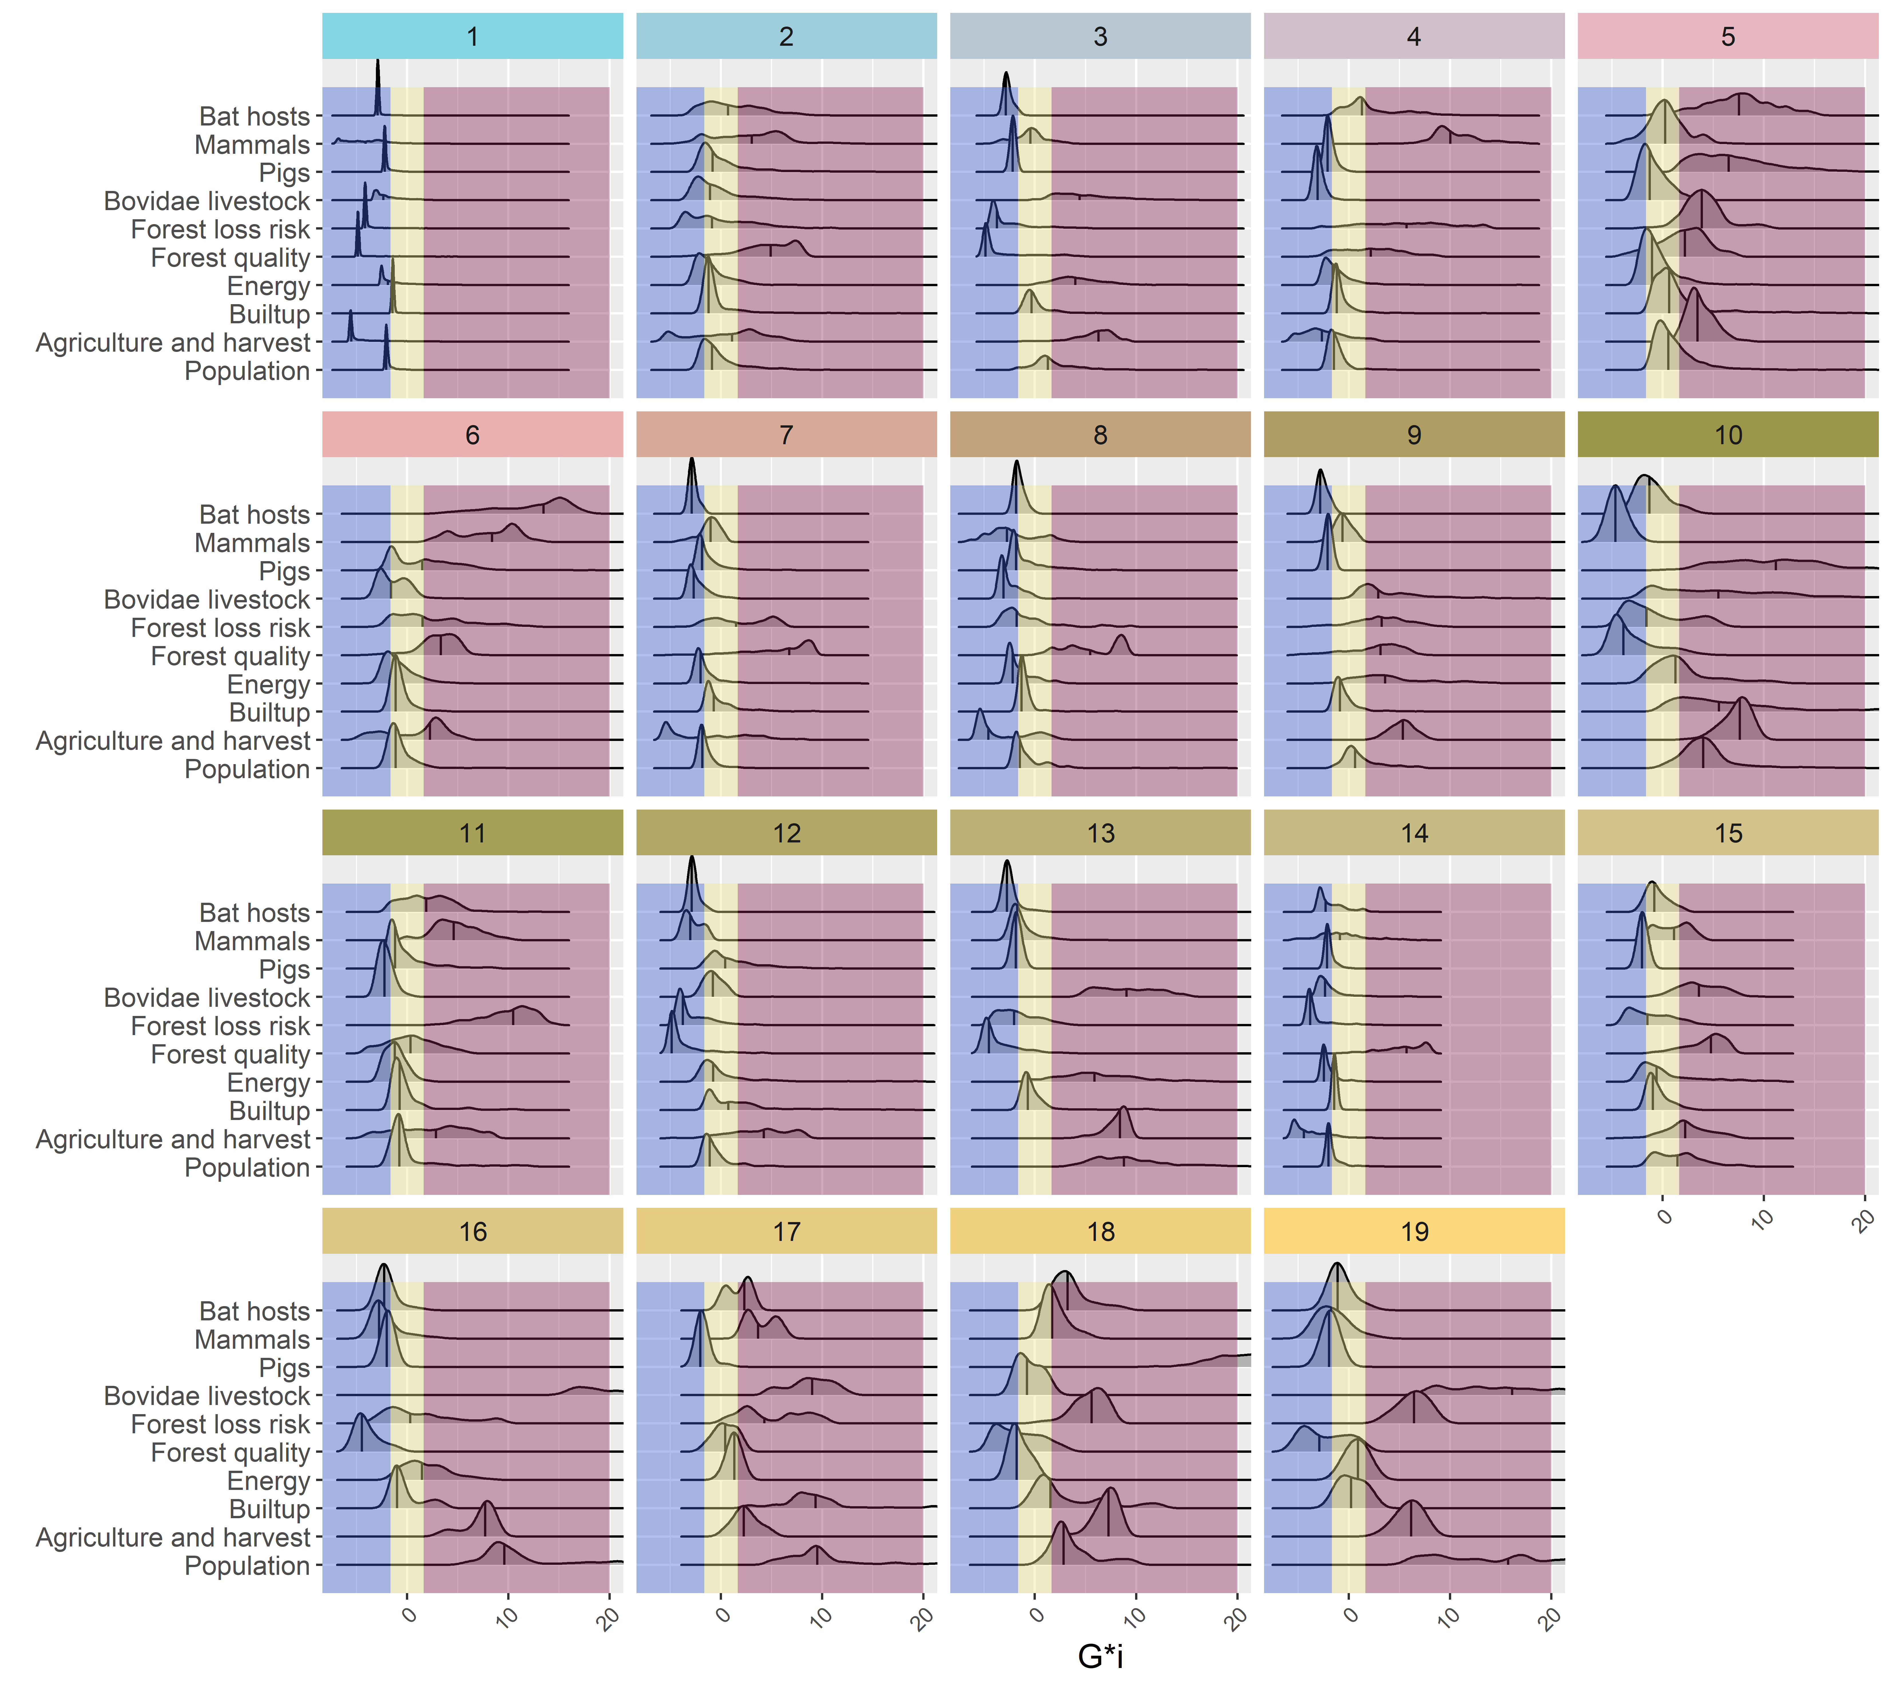

Slide 28
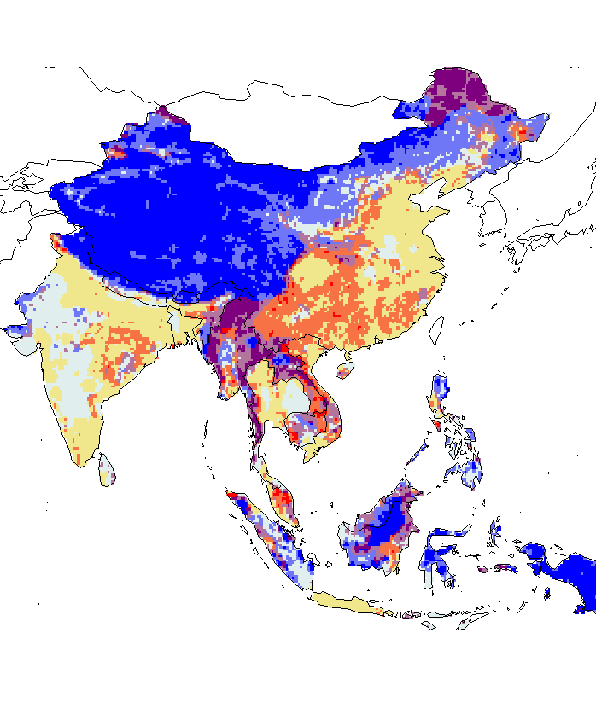

Bat Hosts + mammals mmb + pig + cattle + everything else
- Hazard: Scenario 1 +
- Hazard: Scenario 2 +
- Time to reach healthcare +
- Time to reach healthcare +

Slide 29
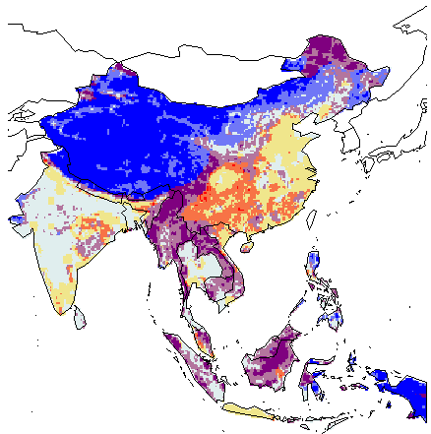
Bat Hosts + mammals mmb + pig + bovidae livestock + everything else
- Hazard: Scenario 1 +
- Hazard: Scenario 2 (all bovidae) +
- Time to reach healthcare +
- Time to reach healthcare +

Slide 30
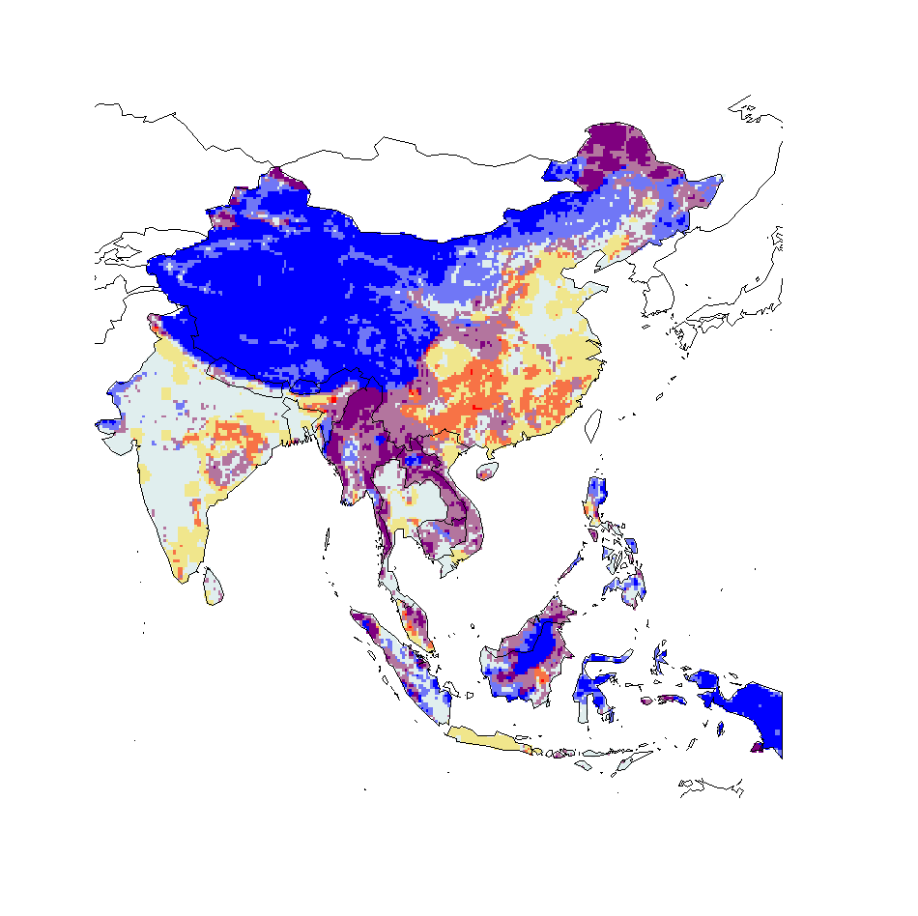
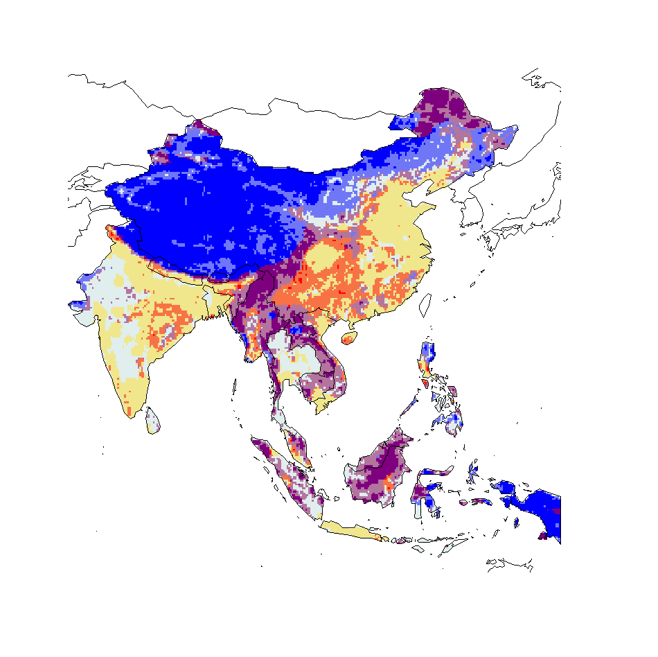
mammals mmb + pig + cattle + everything else
- Hazard: Scenario 1 +
- Hazard: Scenario 2 (mius bat hosts) +
- Time to reach healthcare +
- Time to reach healthcare +

Slide 31

Bovliv mammals minus bat
mammals mmb + pig + bovidae livestock + everything else
- Hazard: Scenario 1 +
- Hazard: Scenario 2 (all bovidae) +
- Time to reach healthcare +
- Time to reach healthcare +

Slide 32
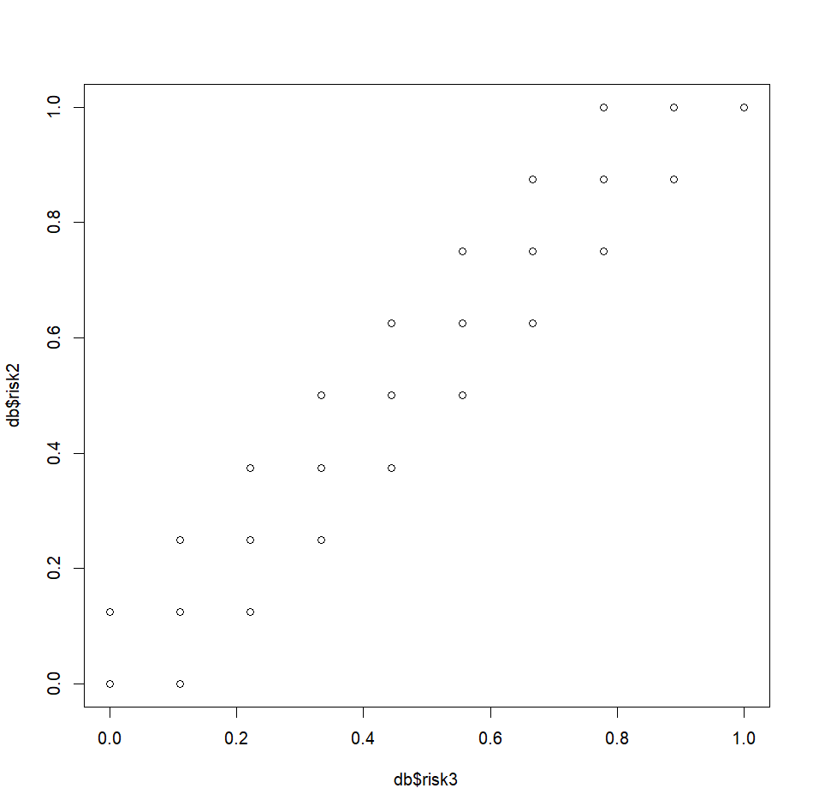
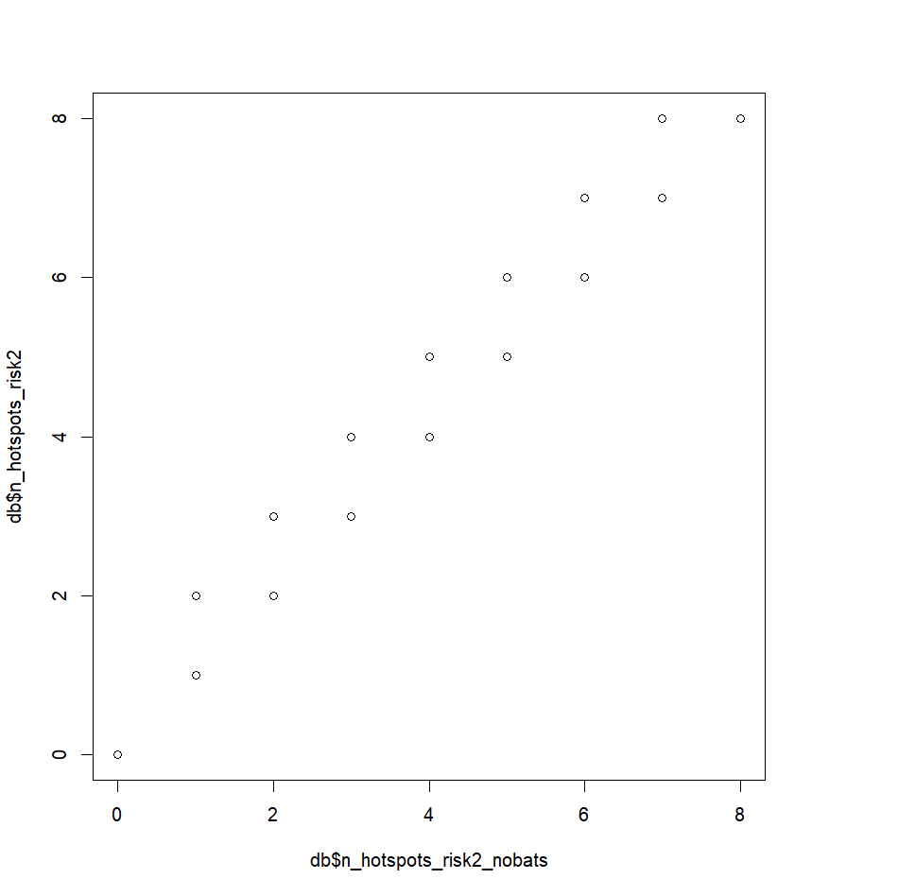
Differences are small
Risk 2 – just cattle
Risk 3 – all bovidae

Slide 33
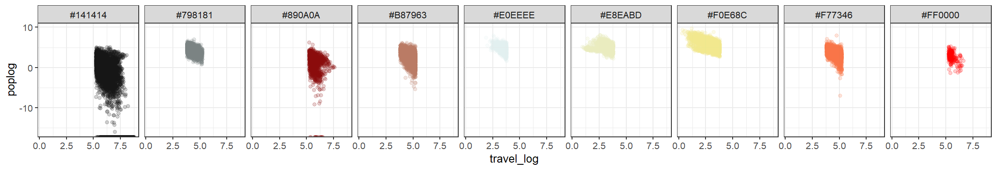
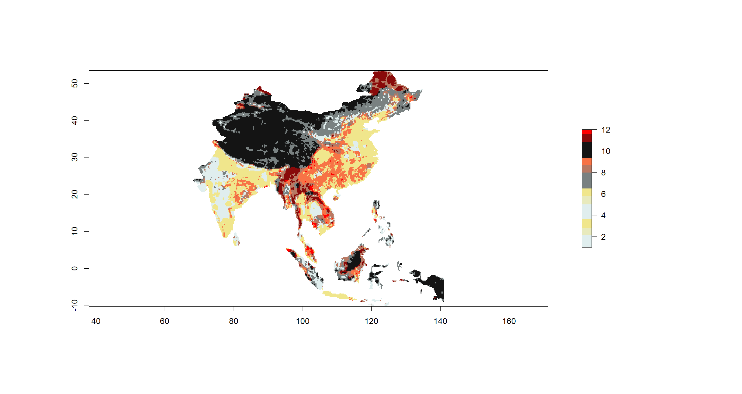
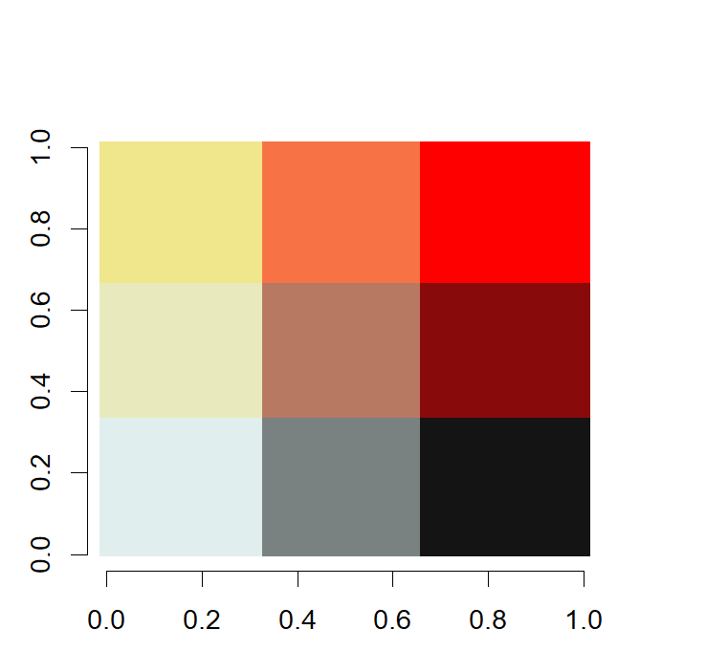
3
9
12
2
8
11
1
7
10

Slide 34
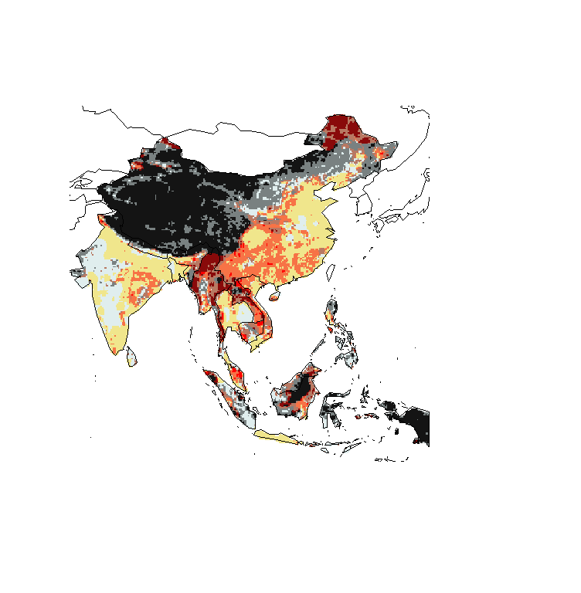
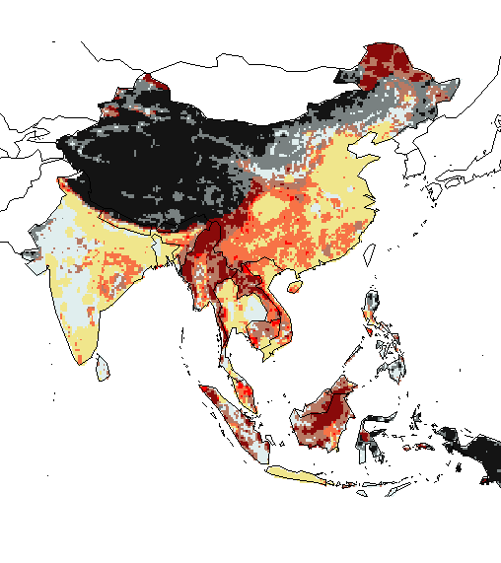
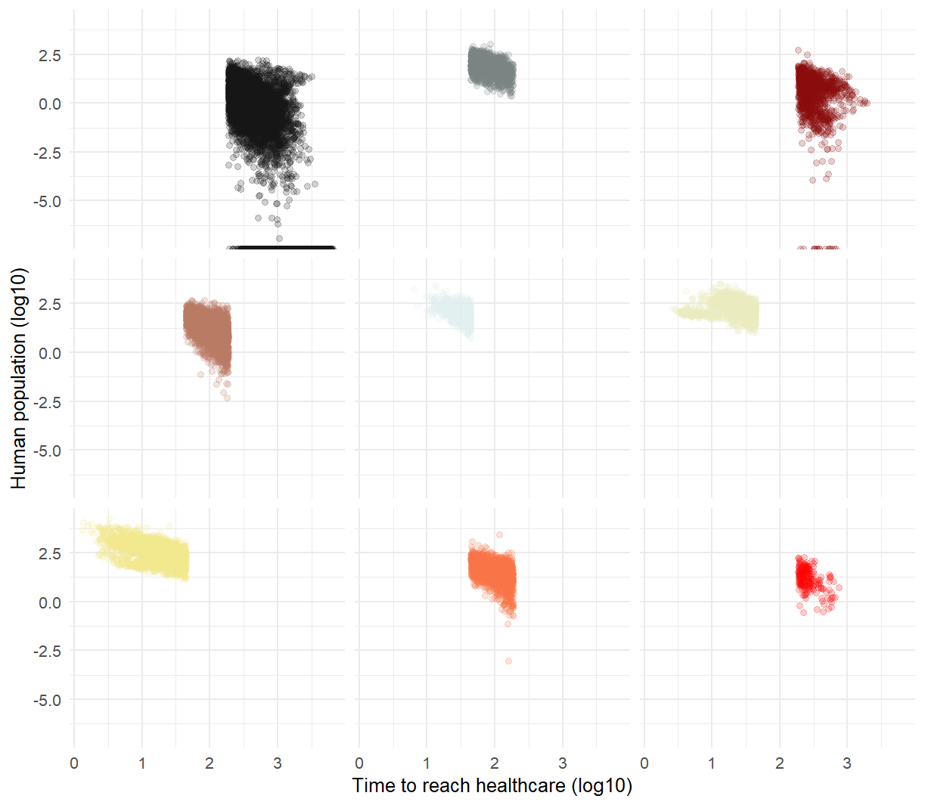
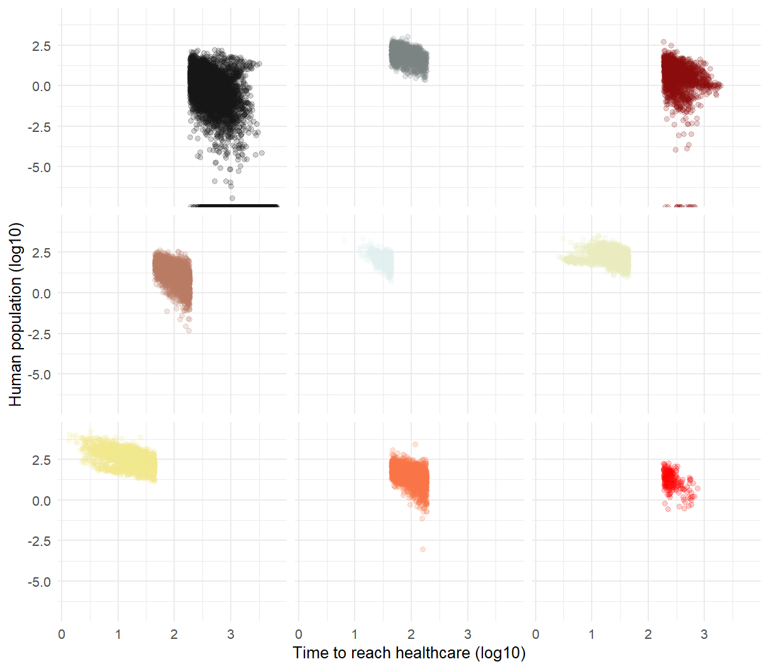
- Hazard: Scenario 1 +
- Hazard: Scenario 2 +
- Time to reach healthcare +
- Time to reach healthcare +

